Slide 1
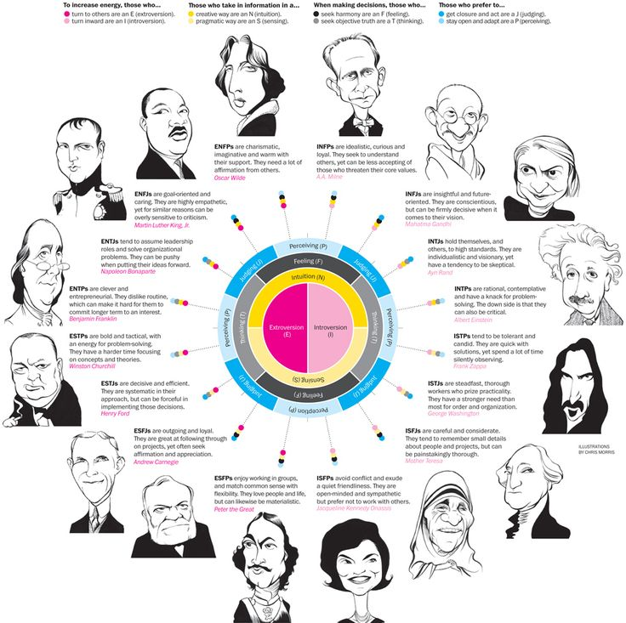
A Level Psychology Transition 2021 Task 8
Aims:
Become familiar with the psychological researcher into personality
Find out your Myers-Briggs Personality Type and reflect on how the knowledge gained can help you get the most out of life
Core tasks must be completed by everyone
Extension tasks are optional

Slide 2
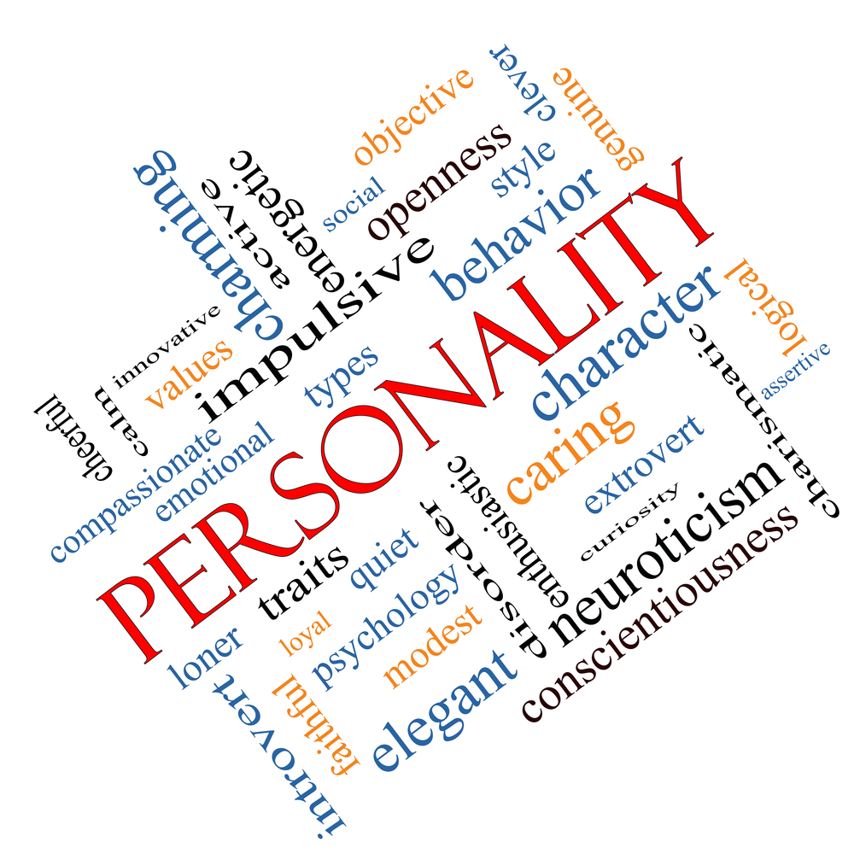
Background Info
Core task: Read this article and answer the following questions:
What does the term ‘personality’ mean?
What is a cardinal trait?
What is the most widely accepted trait theory of personality?
Which is one of the best known but most controversial theories of how our personality develops?
What did Erikson’s theory of personality focus on?
Optional extension which I highly recommend you watch! Biological approach to explaining personality - TED talk

Slide 3
Answers: Core task: mark your answers
1. What does the term ‘personality’ mean?
Collection of factors that make you who you are
2. What is a cardinal trait?
Traits that are so dominant that a person becomes primarily known for those characteristics
3. What is the most widely accepted trait theory of personality?
The big 5
4. Which is one of the best known but most controversial theories of how our personality develops?
Freud’s theory of psychosexual development
5. What did Erikson’s theory of personality focus on?
Social interactions

Slide 4
Core Task
Take the Myers-Briggs Personality Test
Knowing your Myers-Briggs Personality Type can help you understand experiences you may have had in your life and help you figure out what you might want to change in the future to make you happier.

Slide 5
Final core task of the Transition Program!
Please complete the questionnaire
If you do not wish to answer a question, you don’t have to!
Some of the questions will help me get to know you and how you like to learn so I can accommodate your needs to the best of my ability in September ☺

Slide 6
Extension
Create a video/animation or poster educating people about one of the Myers-Briggs personality types (if you do this email it to me at lg@lpgs.bromley.sch.uk – I will display this within the department in September ☺)

