Slide 1
LPGS Sociology Guidance pack

Slide 2
Sociology at Langley Park Girls School- GCSE
Exam board: AQA
A two year course of 100% examination (which will take place at the end of Year 11)
Students should dedicate 1 hour a fortnight writing essays and creating revision resources
Essay workshops are available during the week, along with Sociology club and revision club
Paper 1
The Sociology of Families and Education
50%
Paper 2
The sociology of crime and deviance and social stratification
50%

Slide 3
Sociology at Langley Park Girls School- A Level
Exam board: AQA
A two year course of 100% examination (which will take place at the end of Year 13)
Students should dedicate 2 hours a week writing essays and creating revision resources
Essay workshops are available during the week, along with Sociology club and revision club
Paper 1
Education with Methods in Context
33.3%
Paper 2
Topics in Sociology
33.3%
Paper 3
Crime and Deviance with Theory and Methods
33.3%

Slide 4
Grading in Sociology A Level
With a change in specification, it is important that students maintain their grades throughout the two years
For each student to attain their target grade, improvements suggested from feedback, must be addressed- students should attempt to work on individual targets
D or below
Half of essay is complete
Lack of essay structure
No evaluation
Lack of examples (contemporary and classic)
Lack of revision
C/ B
Essay question addressed
Some evaluation present
Some examples present
Introducing sociological theorists and perspectives
Some essay structure shown
Students attending clubs, workshops and working on feedback when required
A/A*
Essay question completely answered
Evaluation present throughout essay- contrasting perspectives and theories independently
Use of contemporary (recent) and classic examples throughout
Revision resources created and updated frequently
Attending clubs, workshops and working on feedback when required

Slide 5
Assessment Objectives
Achieved by:
Using notes taken from lessons to crosslink ideas
Revision (creating and using revision resources)
AO1: Demonstrate knowledge and understanding of:
sociological theories, concepts and evidence
sociological research methods
draw conclusions
Achieved by:
Maintaining an evidence bank of statistics; current and past events in society and studies
AO2: Apply sociological theories, concepts, evidence and research methods to a range of issues
AO3: Analyse and evaluate sociological theories, concepts, evidence and research methods in order to:
present arguments
make judgements
draw conclusions.
Achieved by:
Using notes taken from lessons to assess pros and cons
Critically thinking throughout lessons and within essays

Slide 6
Sociology A Level essay structure
This structure is essential to gaining a B or above in essays and the exams
P
oint: What is my point? Am I going to present a strength or limitation?
E
xplanation: What do I mean? Why did I say this is a strength or limitation? What is the relevance?
E
xample/ evidence: How can I prove that what I am saying isn’t made up/ my opinion? What could I use to show that this is real in society?
E
valuation: Do all sociologists agree with the initial point? Is this a factual strength or limitation? Is it applicable to all people in society?
L
ink: How does this link back to the question?

Slide 7
Sociology A Level essay structure
30 marks
Introduction
6 x PEEEL paragraphs
Conclusion
20 marks
Introduction
4 x PEEEL paragraphs
Conclusion
10 marks
2 x PEEEL paragraphs

Slide 8
Sentence starters
Other useful sentence starters in a Sociology essay:
Furthermore, it is argued…
As stated in Item…
According to…
Ultimately, this suggests…
Thus proving that…
To support this point…
In contrast…
In comparison…
Moreover, other sociologists…
Point: A strength/ limitation of…
Explanation: This is because…
Example/ evidence: For example…
Evaluation: However, Marxists would disagree. Marxists believe that…
Link: Therefore, _____ is a strength/ limitation of…

Slide 9
Keywords in Sociology
It is essential that sociology students use sociological vocabulary throughout their essays.
There will be a sociological word to illustrate your argument!
Here are some that you may come across frequently in the next two years.
Perspectives
Theory
Sociologist
Sociological explanations
Social solidarity
Cohesion
Value consensus
Socialisation
Fragmented
Diverse
Valid
Knowledge
Value Free
Patriarchy
Oppression
Exploitation
False class consciousness

Slide 10
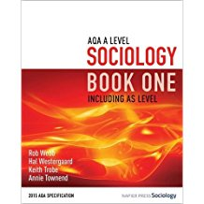
Reading list
Textbooks
David Brown (2019): AQA GCSE (9-1) Sociology Updated Edition (Year 10 and 11)
Keith Trobe et al (2015): AQA A Level Sociology Book One (Year 12)
Keith Trobe et al (2015): AQA A Level Sociology Book Two (Year 13)
Summer reading
Fevre and Bancroft (2010): Dead White Men and other…
Kristoff and WuDunn (2008): Half the Sky
Romero, M (2017): Introducing Intersectionality- Short Introductions

Slide 11
Reading list
Further reading (also available in the Learning Centre)
C. Wright Mills (2000): The Sociological Imagination
Jean Baudrillard (2015): From Hyperreality to Disappearance: Uncollected Interviews
David McCandless (2010): Information Is Beautiful

Slide 12
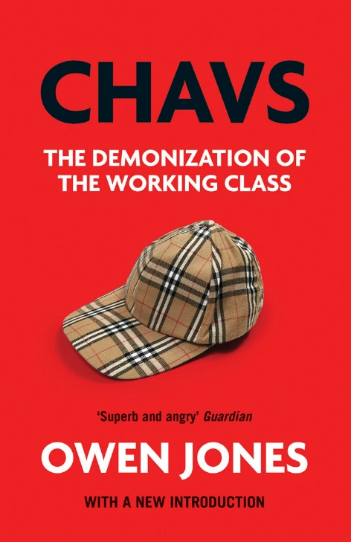
Reading list
Further reading (also available in the Learning Centre)
Paul Gilroy (1987): There Ain't No Black in the Union Jack- the Cultural Politics of Race and Nation
Danny Dorling (2014): Inequality and the 1%
Owen Jones (2012): CHAVS- The Demonization of the Working class

Slide 13
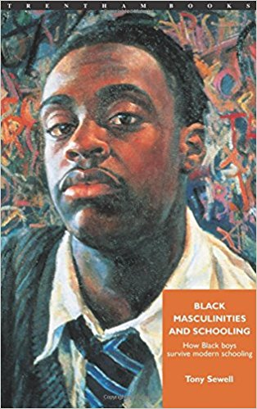
Reading list
Further reading (also available in the Learning Centre)
Anthony Anaxagorou (2016): Heterogeneous
bell hooks (1987): Ain't I a Woman: Black Women and Feminism
Tavis Smiley (2012): The Rich and the Rest of Us: A Poverty Manifesto
Tony Sewell (1996): Black Masculinities and Schooling: How Black Boys Survive Modern Schooling​

Slide 14
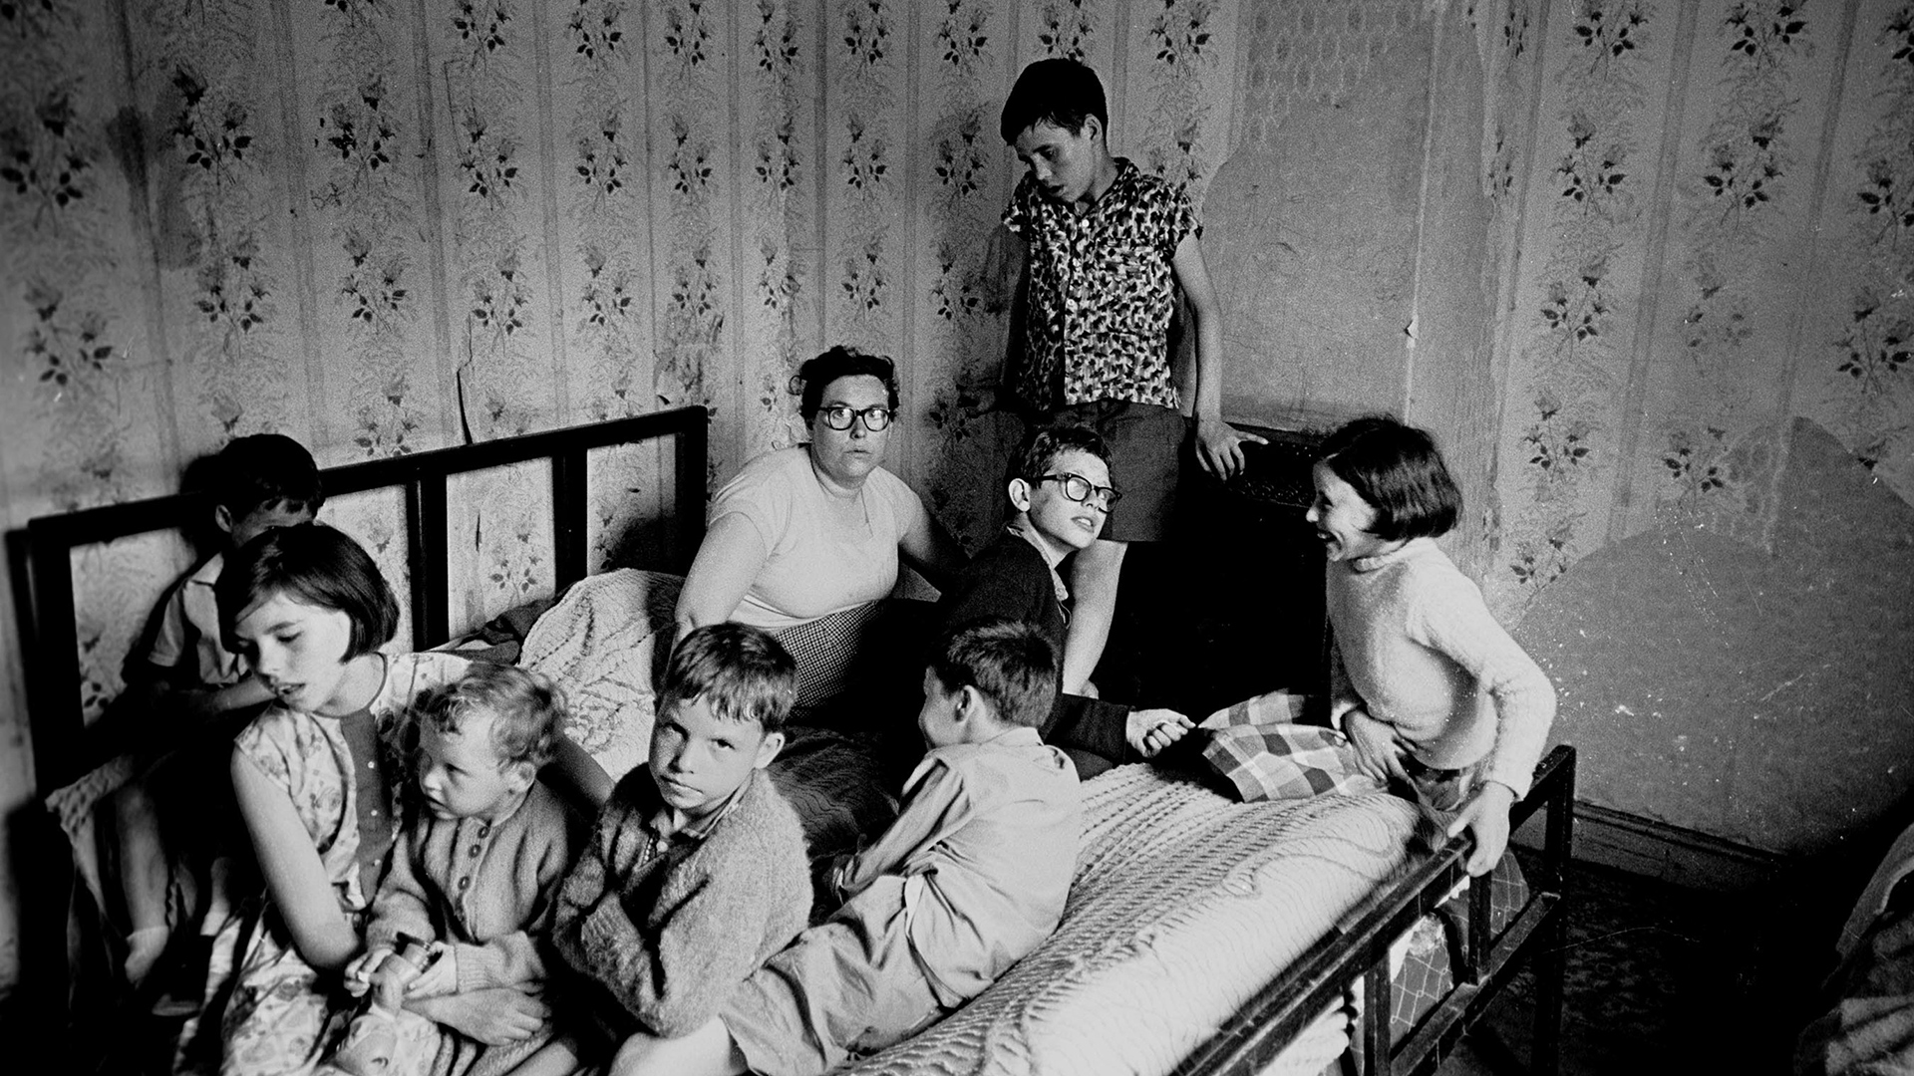
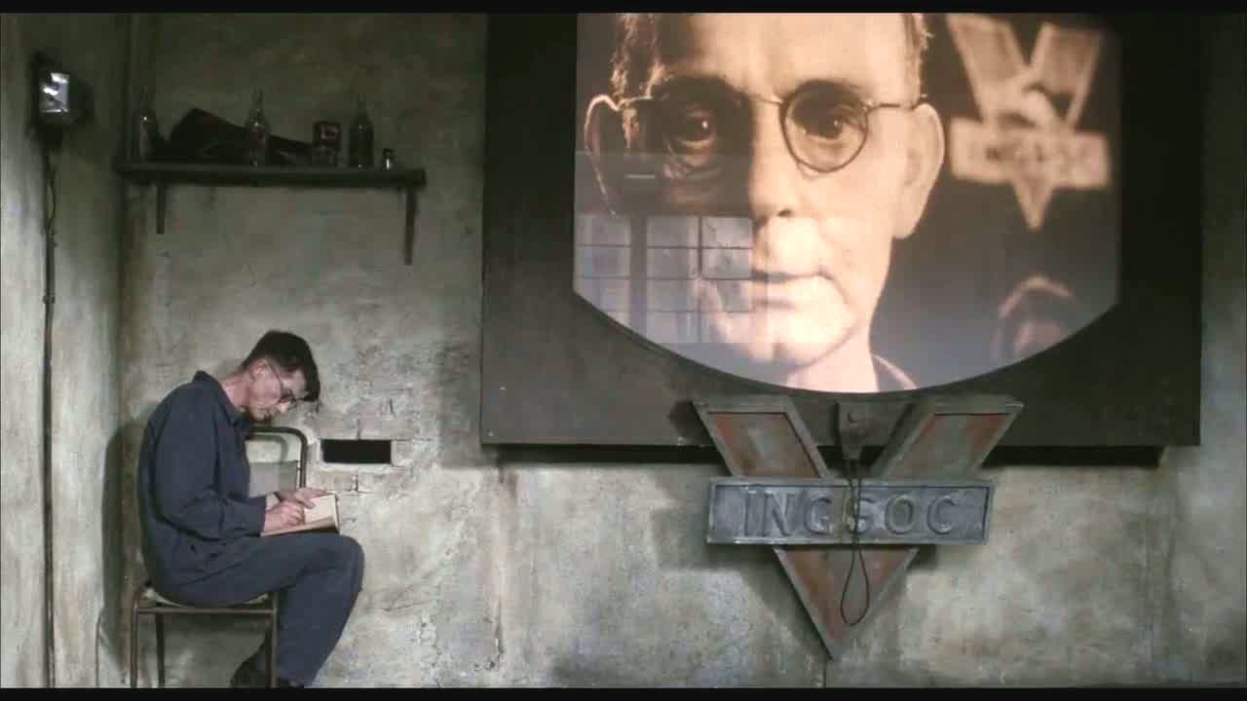
Recommended websites and films
BBC News http://www.bbc.co.uk/news
Al Jazeera http://www.aljazeera.com/
The Guardian https://www.theguardian.com/uk
Joseph Rowntree Foundation https://www.jrf.org.uk/
Office of National Statistics https://www.ons.gov.uk/
‘They Live’ (1988)
‘Excluded- Kicked Out of School’ (2015)
‘Cathy Come Home’ (1966)
‘Slum Britain- 50 years on’ (2016)
‘Nineteen Eighty Four’ (1984)
‘When They See Us’ (2019)

