Slide 1
Spacing & timing of revision

Slide 2
Do you ever wonder why you can’t remember things?
Our brain is designed to let go of millions of bits of insignificant data—images, words, and encounters while it effectively holds onto others.

Slide 3
Your brain needs a prompt
The brain requires a physical “prompt” in order to keep something in long-term memory.
Otherwise, it is designed to let it go.

Slide 4
What is spacing?
Spacing is a revision technique which is all about spacing out your revision so you don’t get swamped and overwhelmed.
It means introducing time intervals into your revision sessions as well as spacing out the days which you revise for topics
To commit something to memory, it takes time and repetition.

Slide 5
Did you know….
WHY?
This is because the time in between allows you to forget and re-learn the information, which cements it in your long-term memory.
Doing something little and often – spacing – beats doing it at once, or cramming.
Revising for eight hours in one day is not as effective as doing one hour of revision for eight days.
https://www.theguardian.com/teacher-network/2017/apr/12/five-proven-hacks-to-help-students-tackle-revision

Slide 6
The ‘Spacing Effect’
The ‘Spacing Effect’ is one of the longest and most enduring findings in cognitive psychology.
It was first detailed in 1885 by German psychologist Hermann Ebbinghaus who found that humans tend to forget large amounts of information if they only learn something once.

Slide 7
Optimum Spacing
Research suggests there is an ‘optimal gap’ between revision sessions so you can retain the information.
If the test is in a month, you should review the information around once a week. If the test is in a week, create time once a day.

Slide 8
Optimum Spacing
Time to the test | Revision Gap
1 Week | 1-2 days
1 Month | 1 week
3 Months | 2 weeks
6 Months | 3 weeks
1 Year | 1 month

Slide 9
The power of spacing- why should you do it?
It allows you time for material to be forgotten and relearnt
It cements information into your long-term memory
We can learn more information over time than in one longer session
It is about revising more efficiently
In some studies, using spacing instead of cramming has resulted in a 10% to 30% difference in final test results.

Slide 10
Create the perfect revision plan using the spacing technique
Organisation: determine where you need to focus your time e.g. which subjects, topics, what you know, what you struggle with etc.
Planning: map out what you are going to revise and when. Use a timetable or revision planner to do this. Choose a mixture of subjects topics to focus on each day to make sure you are spacing them out.

Slide 11
Create the perfect revision plan using the spacing technique
3. Review: build in different revision techniques to help you do some quick 5 – 10 minute reviews of your topics throughout your revision plan. E.g. reading through notes, highlighting information, making post-it notes.
4. Transformation task: These are 30 min activities to help you take in information. For example, writing summary sheets, flash cards or mind maps for topics.

Slide 12
Create the perfect revision plan using the spacing technique
5. Practice testing: test yourself on the area that you have reviewed such as quizzes or testing yourself with a friend.
6. Exam questions: complete an exam question or questions on the area you have reviewed and mark this yourself using a mark scheme.

Slide 13
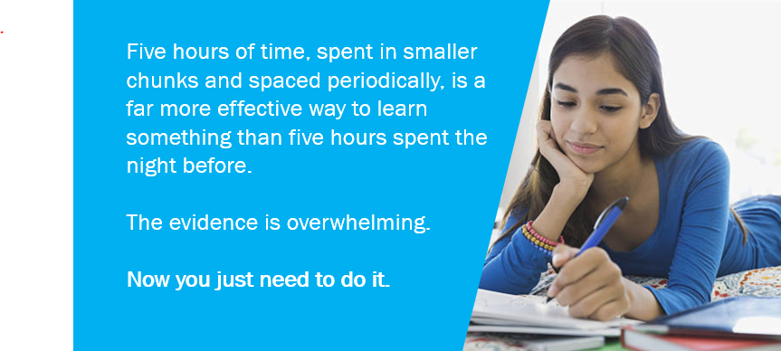

Slide 14
Top tips to manage your revision time
Know what your revision goals are and set aside blocks of time.
Don’t work too much – work smarter, not harder.
Establish good habits and a structure revision routine.
Don’t procrastinate- don’t waste precious time worrying or thinking about what to do –just do it!
Review your work – prompt your brain with short review exercises.

Slide 15
To commit something to memory, it takes time and repetition

