Slide 1
The ‘Interleaving’ technique to help revisit information

Slide 2
Have you ever crammed for an exam?
Did you find it challenging?
Interleaving is a method to use when revising to help you remember more for the exam and to understand it better as well!

Slide 3
What is Interleaving?
Interleaving study technique is about what you do with your time when revising.

Slide 4
And then another day to revise for a different subject?
Have you ever dedicated a whole day to revise for one subject?
This is known as ‘blocking’

Slide 5
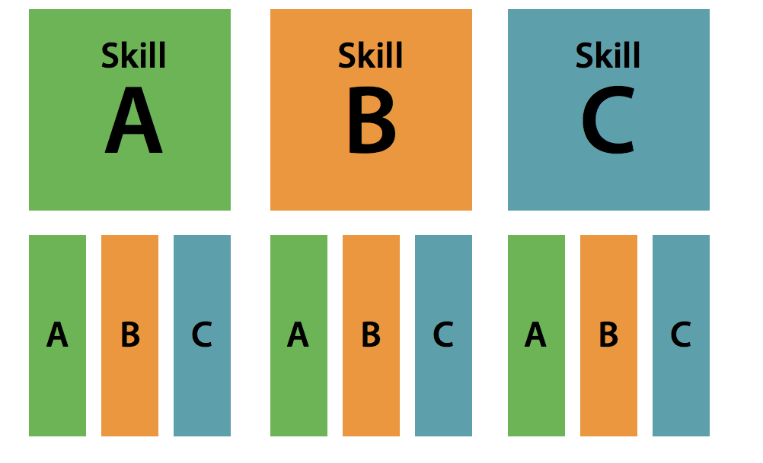
How does interleaving work?
Blocking vs Interleaving
Learning is spread over time rather than concentrating on narrow topics one after the other

Slide 6
The evidence to show it works…
A study examined the performance of maths students who revised using blocking compared to those who used interleaving.
Students who used interleaving performed better on the examination if the examination was more than one day away.
https://6med.co.uk/guides/study-tips/the-power-of-interleaving/

Slide 7
The research
Pan (2015) says ‘Mixing it up boosts learning’ compared to more traditional methods of block learning where students master one topic before moving on to the next in preparation for exams.
Pan, S (2015) Up Boosts Learning. Scientific American.August 4. http://www.scientificamerican.com/article/the-interleaving-effect-mixing-it-up-boosts-learning/

Slide 8
What are the benefits of Interleaving?
Your brain is continually changing focus and attempting to find different responses to bring into your short term memory

Slide 9
What are the benefits of Interleaving?
Each time you revise information it strengthens your memory recall.
By revisiting material from each topic several times, in short bursts, you can increase the amount you remember in the exams.

Slide 10
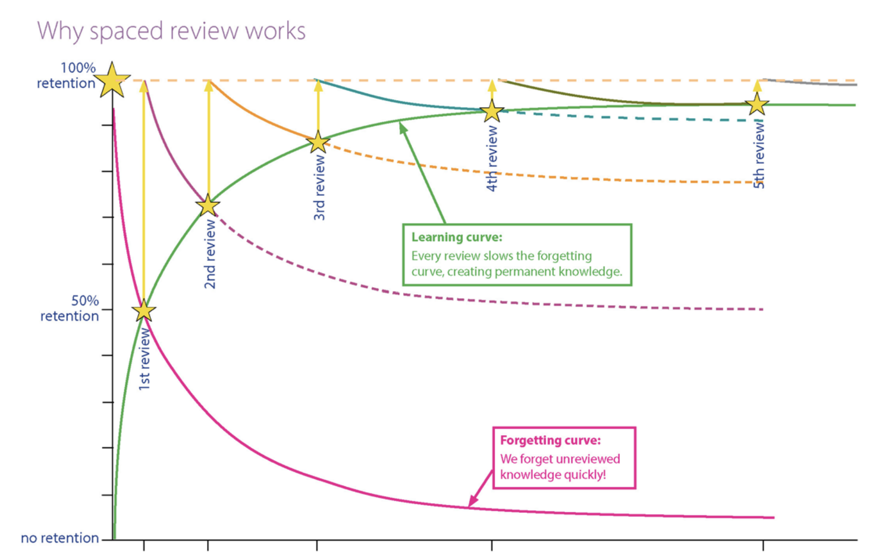
The learning curve and forgetting factor
OCR produced a learning curve & forgetting factor curve to demonstrate the benefits of interleaving practice
https://www.ocr.org.uk/Images/340584-spaced-review-and-interleaving-teacher-guide.pdf

Slide 11
Video - Interleaving

Slide 12
Applying effective interleaving
Break units down into small chunks and split these over a few days rather than revising one whole topic all at once.
Decide on the key topics you need to learn for each subject.

Slide 13
Applying effective interleaving
3. Create a revision timetable to organise your time and space your learning.

Slide 14
Focus on quality and not quantity- short targeted bursts are more effective

Slide 15
Do little and often, and mix it up everyday!
Variety is, after all, the spice of life!

