Slide 1
A Level Psychology Transition 2021
Task 1
Aims:
Become familiar with what we mean by: aims, procedure, findings and conclusions of psychological studies
Become familiar with the research of social psychologist Philip Zimbardo
Learn the useful psychology study technique of making a key study fact-file, realise how it helps you remember key facts of a study

Slide 2
Key Terms
Aim: What the researcher wants to find out
Procedure: What did the researcher did
Findings: What did the research find?
Conclusion: Based on the findings what did the researcher suggest about human behaviour/psychological functions

Slide 3
Study Fact Files
Research study fact files are a good way to condense study descriptions into the key information
Try to make your points concise, using only the bare minimum words that will act as trigger for you
Aim:
Procedure:
Findings:
Conclusion:
A fact file of about this size is perfect for concise revision notes. Also, the process of reducing your notes helps consolidate your memory of the study!

Slide 4
Philip Zimbardo
Well-renowned social psychologist
Conducted the Stanford Prison Experiment (SPE)
Task:
Write the following words, well spaced out, on an A4 sheet of paper: Aim, Procedure, Findings and Conclusion
Listen to this podcast and take notes on the aim, procedure, findings and conclusion A4 sheet of paper: https://www.bbc.co.uk/sounds/play/b008crhv
3. Check the following source to see if you missed any details:
4. Redraft your notes to make a concise fact file (see previous slide)
5. Take the quiz (Firefly Quiz, in the same folder as this PowerPoint)
https://www.tutor2u.net/psychology/reference/conformity-to-social-roles-as-investigated-by-zimbardo

Slide 5
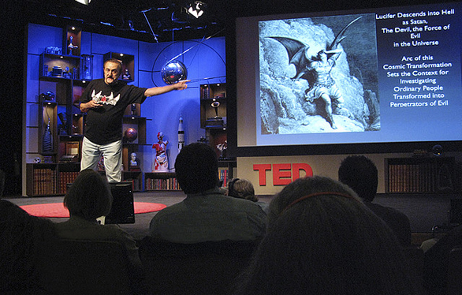
Extension Activity
Watch the following Zimbardo lecture.
https://www.ted.com/talks/philip_zimbardo_the_psychology_of_evil?language=en
Do you think people do bad things because of their genes or because of their environment? Once you’ve watched this video, share your thoughts on the psychology transition forum!

