Slide 2
Preserve cell formatting & autofit column width

Slide 3
KS2 Mean Vs Summer exam

Slide 4
Tracking HWK completion Vs MEG
See 4s

Slide 5
PP performance/remote tasks

Slide 6
Performance by MEG
See 6s

Slide 7
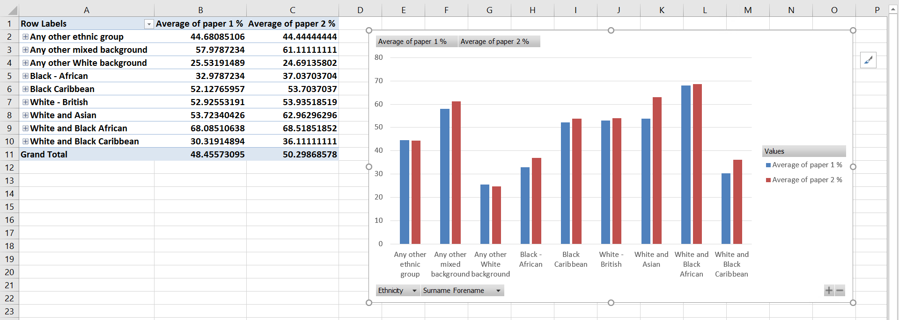
Ethnicity vs performance

Slide 8
Test run
Open spreadsheet

Slide 9
Other ‘tricks’
Collapse/expand entire field (e.g. by target grade)
Double click to get data in a report (hwk, sub-totals)
Adding filters – e.g. on homework
Swapping data doesn’t affect it (swap PP for EAL) so you can mess about in a pivot table and your original data stays ‘safe’

