Slide 1
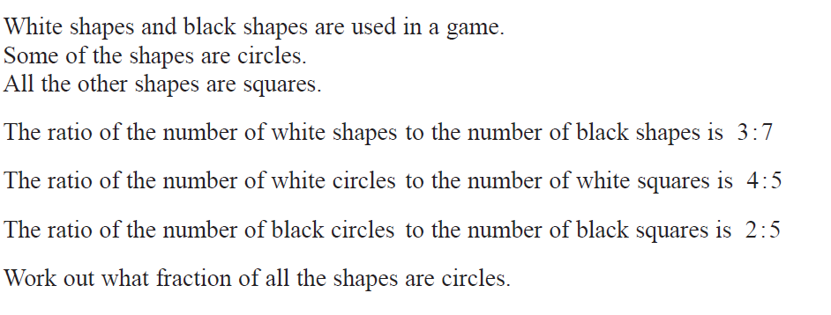
Higher June 2017 Q 14

Slide 2
Higher June 2017 Q2

