Slide 1
Choose your favourite book cover and write a brief exploration of what you think it might suggest about the ideas explored in the text
Hint: Could you consider the portrayal of identity in the Vintage Atwood cover?

Slide 2
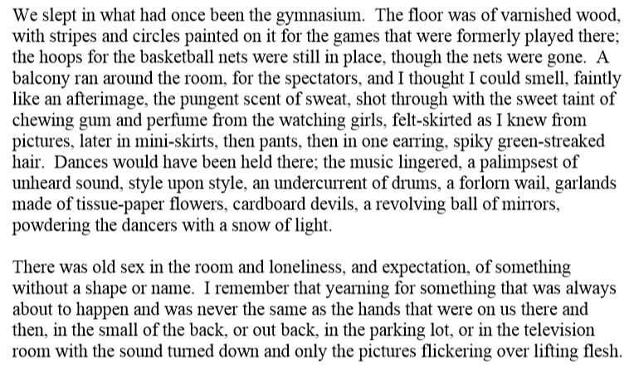
Read Chapter 1 of ‘The Handmaid’s Tale’

Slide 3
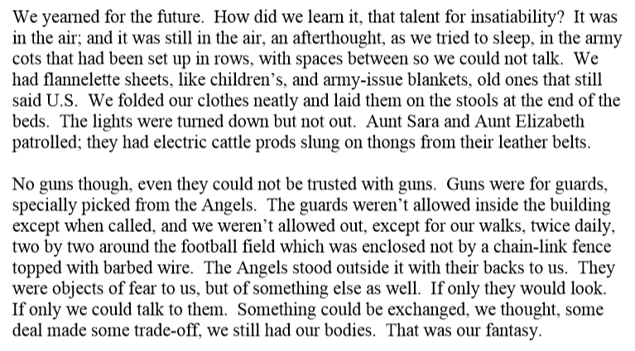

Slide 4
What is the effect of this chapter as the opening to the novel? Make a list of questions it raises for the reader
Example:
Why are they using a gym as temporary accommodation? Is there a war?
Please refer to the grid the analysis/evaluation column of the grid to challenge yourself with higher order thinking questions

Slide 5
What do you find interesting about this extract?
Points to consider:
The characters’ names
The conditions they are in
The setting
The shifts in tense

Slide 6
Read the article below
https://www.penguin.co.uk/articles/2018/margaret-atwood-interview/
Based on the opening and Atwood’s interview – How can fiction be used as a medium to convey/explore ideas?
Write a response to this question using evidence from the opening and the interview.

