Slide 1
What might be the different conventions of these text types?
Speech
Political
Essay
Guide
Satire
News article
Review
Obituary
Informal
Semi-scripted
Information piece
Lecture transcript
Alternative
Graphic Novel
Twitter Feed
Letters and Diaries
Intimate correspondence
A primary historical source
An introspective exploration of self
What language features would you expect to find in these types of text?

Slide 2
What are the conventions of an obituary?
Obituary: a notice of a death, especially in a newspaper, typically including a brief biography of the deceased person.
Make a list….

Slide 3
What are the conventions of an obituary?
Obituary: a notice of a death, especially in a newspaper, typically including a brief biography of the deceased person.
Did you think of the following?
Third person; formal; factual
Positive lexis (semantic field) employed relating to the life of the individual
Noun phrases; pre/post modifiers
Euphemism referring to death
Identification of a notable accomplishment
Mention of a distinctive characteristic / physical appearance
Quotation describing the deceased from someone who knew them well

Slide 4
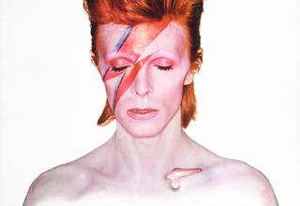
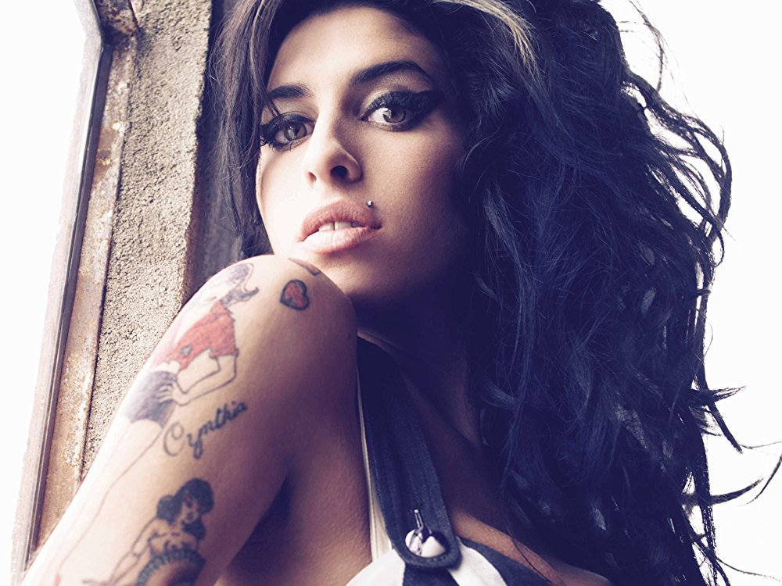
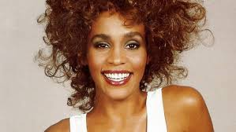
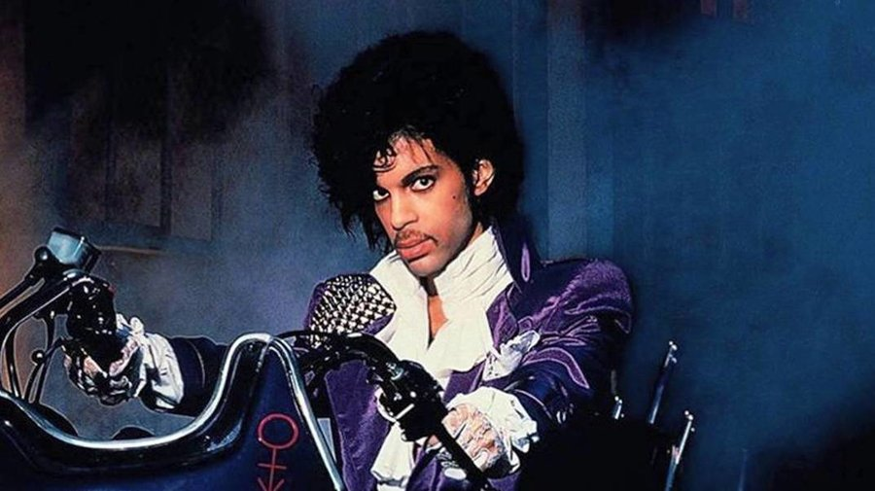
Task: Choose one of the obituaries to read… First impressions?

Slide 5
Does the writer of your allocated obituary adhere to the conventions of this text type? How? If not, why do you think this is?

Slide 6
Next, consider the following:
Purpose – other than informing the reader of the death of this individual, can you identify any other (perhaps more subtle) purposes (e.g. to highlight how vulnerable young celebrities in the spotlight are)
Audience – Is this obituary written for music lovers? A particular gender? Is it from a publication which has a particular agenda?
Context – you might like to think about the circumstances surrounding the death of this individual? What is happening in the world that has influenced the writer?
Mode – How formal/informal is the writing style? Are there factors at play here, for example the type of publication this obituary features in?
Language – How figurative is the language used? What do you notice about the writer’s lexical choices? Noun phrases and pre/post modifiers? Verbs? Euphemisms?
Sentence structures – how long/short are the sentences? Is there evidence of listing? Is this syndetic or asyndetic?

Slide 7
Now choose one more obituary to read. How does this obituary compare to the first one that you read? Does it adhere to typical conventions of an obituary?

Slide 8
L/O: Drawing on your reading – identifying the conventions of a non-fiction form and using them to develop your own writing style
Original Writing task
Either: Write an obituary about a celebrity or famous person who has died recently.
Stretch: underpin the writing with a discursive argument about a relevant topic, eg: Sophie Gradon – ex love island contestant, using the obituary as a platform to argue against reality TV
OR:
Write the obituary of a fictional character. Perhaps this could be the protagonist of the novel you are currently reading, or a film you have recently watched.
Write a satirical obituary about the death of something topical.
Love
Feminism
Free will
Your social life (under quarantine!)
Building skills for original writing coursework at the end of Y12

