Slide 1
Part 1: Helping Students Manage Their Remote Workload Part 2: Remote AFL
Discuss with your neighbour or list things that make you feel stressed at work.
Can you spot anything they all have in common?
Some slides are narrated to add extra details that would have been shared in the session.

Slide 2
The Whitehall Studies (1994)
For an in-depth overview of Marmot’s work Take a listen to Marmot talk on Radio 4
LGL narration
Notes:
Mortality rate, or death rate, is a measure of the number of deaths (in general, or due to a specific cause) in a particular population, scaled to the size of that population, per unit of time. For every 1 top official who dies, 1.5 clerical staff would die.

Slide 3
What causes stress at work?
High workload + High control | High workload + Low control
Low workload + High control | Low workload + Low control

Slide 4
What causes stress at work?
LGL narration:
High workload + High control | High workload + Low control
Low workload + High control | Low workload + Low control
A situation where we have a lot to and little control over when we do it and how we do it causes the most stress (although there will obviously be individual variations based on personality factors – more on this later).
Why is this relevant to our students? Why is it even more important to keep this in mind when we are working remotely?

Slide 5
It’s raining tasks again! Will it rain next week too?
LGL narration

Slide 6
Solution?
LGL narration
Planning each half term’s work in advance, with key assessment and consolidation tasks specified in advance allows you and your students know what’s coming
Everyone can plan their workload and their TIME OFF accordingly
If students know what is coming, they can take more control of when they do it, the safety of knowing nothing else is going to be ‘thrown’ at them allows ticking things off their to-do lists to be a fun experience
Where possible we can offer an extra layer of control and allow students ownership over how they do their tasks

Slide 7
LGL narration

Slide 8
Individual differences to be aware of …
Some students will have many responsibilities at home to juggle with their schoolwork (caring for family members, sporting or musical commitments etc.)
Some students have high sensory processing sensitivity than others (about 20% of our students will be Highly Sensitive People (HSPs), as will 20% of staff at the school), HSPs become easily overstimulated when they have too many things to do and experience emotions very intensely (Find out more about HSPs here)
Some students have greater intolerance of uncertainty than others
Some students have a more reactive stress response than others

Slide 9
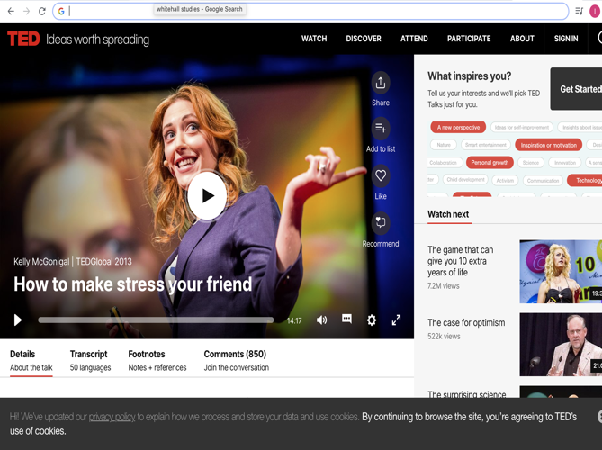
It is important to perceive demands as challenges
Watch this video: Making stress your friend requires being able to have a sense of control
If we allow students and ourselves some control over workloads, we can make our stress responses healthier!

Slide 10
Remote AFL (quick and easy)
What is the easiest way to know where someone is at in their understanding of a topic?
How can we do that remotely?

Slide 11
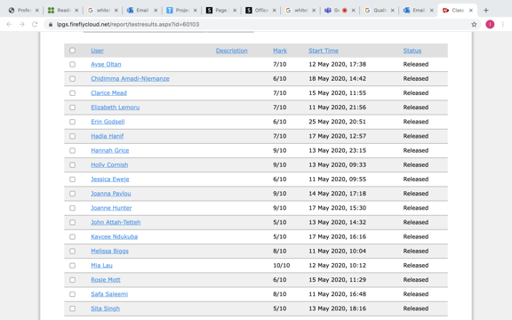
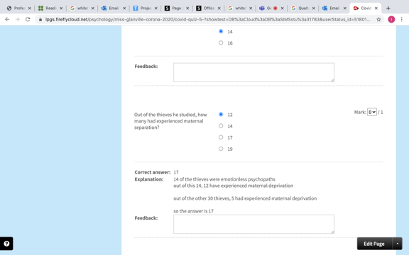
Possible Solution
After each teaching session set students a timed quiz on firefly (you may not think a quiz can be used in your subject, but I accept the challenge of helping you use this strategy – so just email me!)
Firefly marks their work for you!
Look at what students have an haven’t understood, use this information to plan your targeted questions for the next ‘live’ session with students
LGL narration
In your targeted questioning, you can check they learnt from the explanation provided automatically with their quiz grade!

Slide 12
Another Possible Remote AFL Solution
Follow Charlotte Ashworth’s advice and use the verbal feedback function in the Firefly App
Set an essay
Quickly read the first draft submitted and give verbal feedback to help the student redraft. Ask students to highlight or use track changes to show what they have changed as a result of your feedback.
Student redrafts the essay and resubmits
You can either now mark it in written or verbal form and assign a grade

