Slide 1
Studying Narrative Texts
Component Three of A Level Language & Literature is called ‘Reading as a writer, writing as a reader.’
In this unit, you will critically read a novel, and also write a short narrative text of your own.

Slide 2
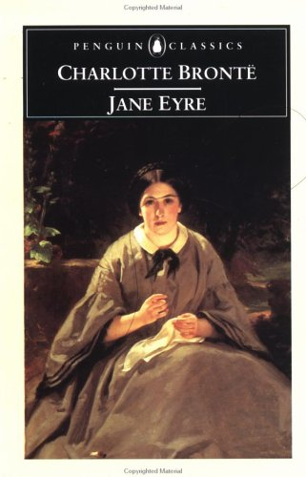
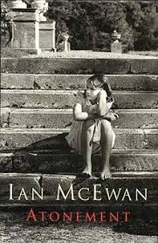
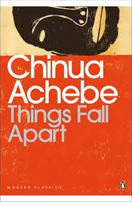
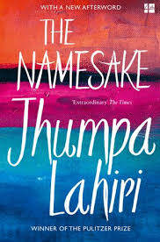
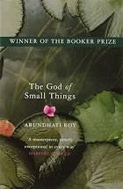
The novel you study will be one of the following…

Slide 3
The exam is open text, so you will have a clean copy of the novel with you.

Slide 4
You will need:
a good sense of the novel as a whole
the ability to comment closely on key passages and range around the text
an understanding of the narrative genre more generally.

Slide 5
A first exploration – what can you discover?
The extracts on the next few slides are all taken from the narrative set texts.
Read the extracts and list everything you can tell about the way narratives work, based on these extracts.
For example:
In some novels, one of the characters takes the part of the storyteller.
Some narratives seem to announce what they are – almost like an introduction – while others launch you straight into the action, as though you are familiar with the world already.

