Slide 1
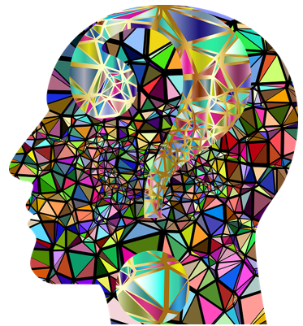
Cognitive Load Theory
Helping you to revisit and learn information

Slide 2
‘Cognitive Load’ Theory was developed by John Sweller out of the study of problem solving.
It offers a handy model to understand challenge and how to learn information which isn’t too hard, not too easy, but just right. (Sweller 1998)

Slide 3
What is cognitive load?
Cognitive load is the amount of information our working memory can hold at any one time.
The working memory is where we process information and is key to learning.

Slide 4
How do we process information?
Huge amounts of information anywhere from a day to a life-time
2-3 seconds
5-7 items for
5-20 seconds
Input
Sensory memory
Working memory
Long-term memory
Encoding
Input
Attention
Retrieval
Input
Rehearsal

Slide 5
The capacity of our working memory is limited
We must manage the ‘load’ of our working memory. We must maximise our working memory by practicing a range of strategies.
What does this mean?

Slide 6
What types of working memory are there?
1. Intrinsic Load – this means how complex a task is.
If a task or problem is really complex then it can take over most of our working memory.
If a task is simple it uses less working memory.
Can you think of a task which was really difficult?
How did it make you feel when attempting to answer it?

Slide 7
What types of working memory are there?
2. Extraneous Load – these are the instructions you are given or how questions are written.
Incomplete instructions take up space in working memory and don’t help you learn.
What does this mean? You should ALWAYS ASK if you don’t understand something.

Slide 8
What types of working memory are there?
3. Germane Load
This is the amount of work you put in to create a permanent store of knowledge.

Slide 9
How can you apply the cognitive load theory to help you revise and learn?
Break the problem down into parts. This reduces the problem space and lightens the cognitive load, making learning more effective.
Look at worked examples to understand how to complete tasks.
Take advantage of auditory and visual channels in your working memory.
Start with learning simple information and build on it.

Slide 10
What should you do to help your working memory perform better?
5. Create an environment with as few distractions as possible so turn off your phone, music or the TV. Distractions add to your working memory.
6. Avoid overloading your brain with too much information at one time.
7. Always review information from your lessons as you go along because this will help improve your retention, adding knowledge to your long term memory.

Slide 11
What should you do to help your working memory perform better?
8. Focus on one task or topic at a time.
9. Rehearse the components of a complex task so that it becomes automated, thus freeing up working memory capacity.
10. Create stories from information to be remembered or group information into more memorable categories or more accessible chunks.
https://educationendowmentfoundation.org.uk/tools/guidance-reports/metacognition-and-self-regulated-learning/

Slide 12
Did you know…
The mind processes visual and auditory information separately BUT
Too much visual and text displayed together compete with each other in your mind.

Slide 13
Top tip to help you revise…
When you have multiple sources of visual information, such as diagrams, labels and explanatory text, your attention is divided between them. This adds to the cognitive load, making it more difficult for you to learn.
Incorporate labels into diagrams rather than writing text in separate boxes.
Use acronyms to help you learn so information can be ‘retrieved’ easier from your memory.
Try talking through the problem out loud.
Watch videos with animation and voiceovers.

Slide 14
How will using the Cognitive Load Theory impact your learning?
improve your long term memory and knowledge
help learn new skills more easily
remove unnecessary distractions
reduce anxiety and sense of being overwhelmed

Slide 15
How are you going to use ‘Cognitive load’ to revisit information?
Choose your top 3 actions you are going to focus on.
Discuss with a partner how you are going to achieve them.

Slide 16
Don't overload your brain when you want to learn more efficiently

