Slide 1
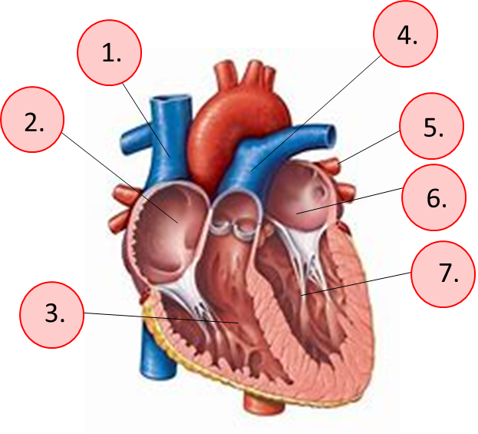
The heart is the most important organ of the cardiovascular system
It is a double pump. It moves blood to two locations at the same time, the lungs and the rest of the body.
Can you name
these features?
(1-7)

Slide 2
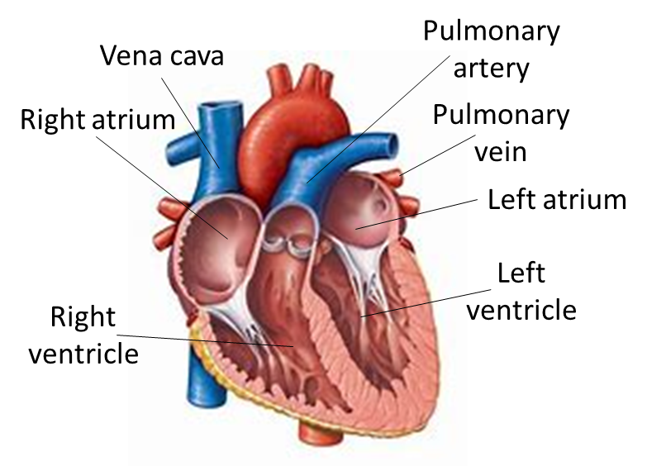
The heart is the most important organ of the cardiovascular system
It is a double pump. It moves blood to two locations at the same time, the lungs and the rest of the body.

Slide 3
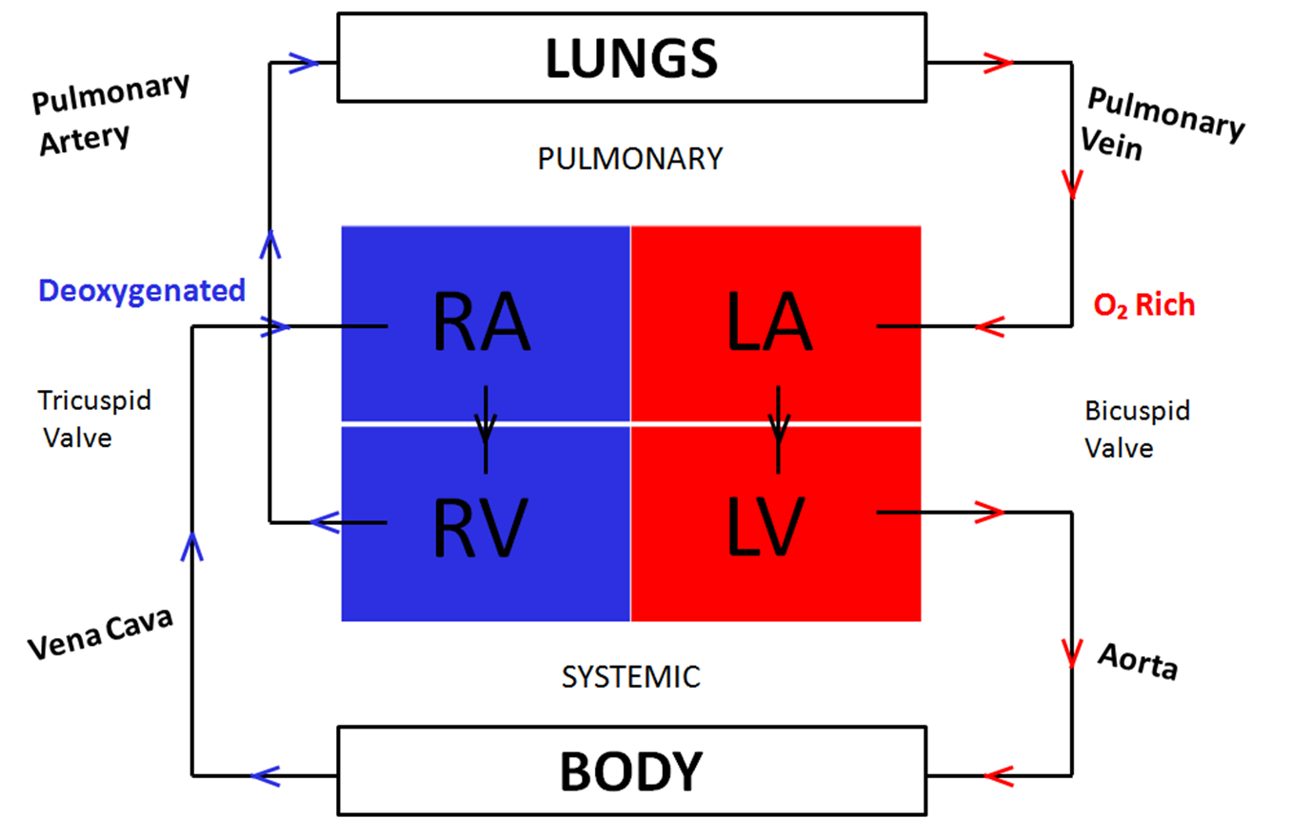
A double pump is needed because humans are very active and so need a lot of energy. Since energy is released by respiration, this requires a lot of oxygen and glucose – transported by blood.
A double pump enables blood to be moved more quickly around the body using high pressure, but more slowly under low pressure passing the lungs, where maximum oxygen can be collected.
energy released
Glucose + oxygen Carbon dioxide + water
Low pressure
Low pressure
High pressure
High pressure

Slide 4
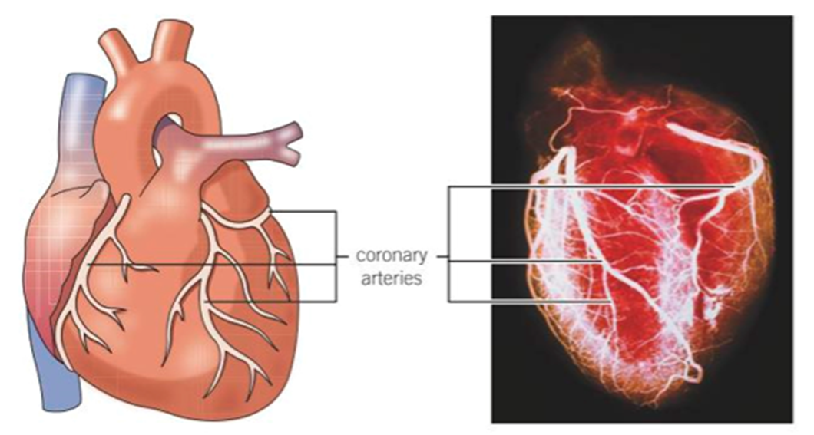
If the heart stops pumping, oxygen and glucose cease to be delivered around the body by the blood. Thus, very quickly, the cells of the body start to die, because they can no longer release energy. Therefore, anything that damages the heart is a serious threat to life.
Damage to the heart
Fatty deposits can build up in the coronary arteries that supply blood to the heart. This will reduce blood flow and therefore oxygen supply.
Ultimately, heart cells can die through lack of blood supply.

Slide 5
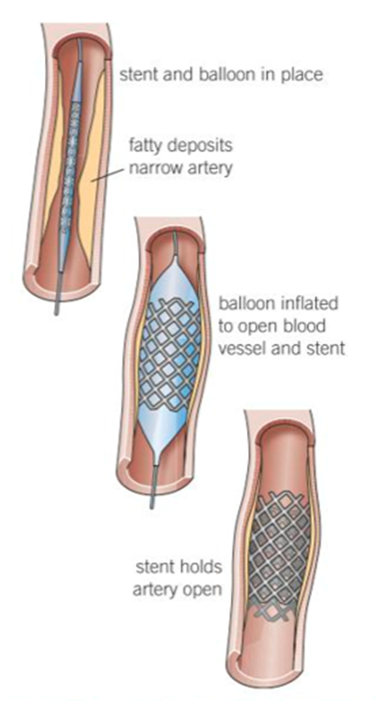
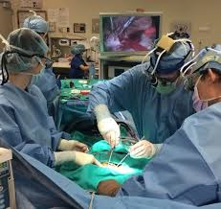
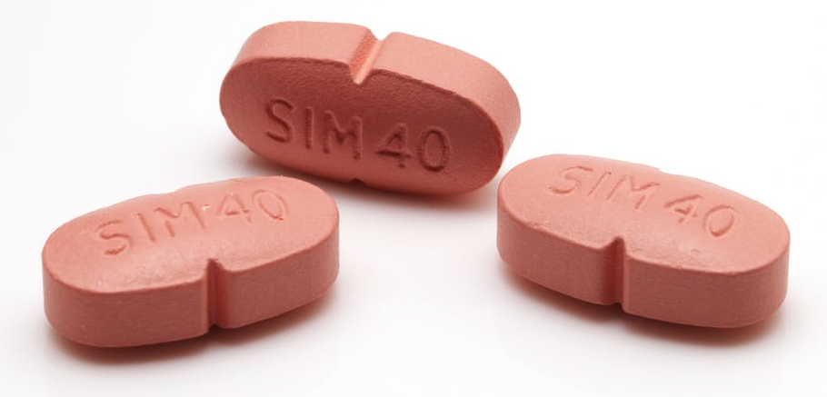
Stents are used to open up blocked arteries.
Surgery can bypass blockages.
Statins can prevent blockages developing,
by lowering cholesterol.

Slide 6
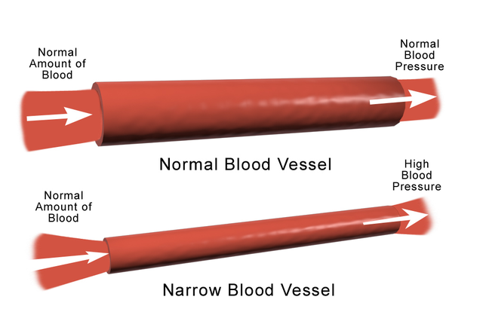
The heart can also be damaged because of high blood pressure or hypertension. If arteries are narrowed because of fatty deposits, or are less elastic because of smoking, the heart has to work harder to pump blood. This, in turn, can cause more damage to the arteries, which can even lead to them narrowing further – causing even more damage. This is a feedback cycle.

