Slide 1
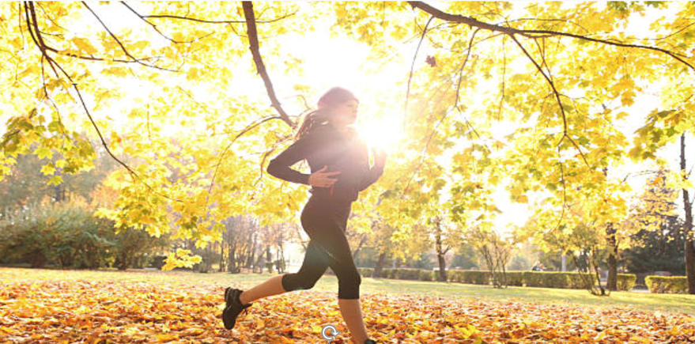
Keeping active during revision

Slide 2
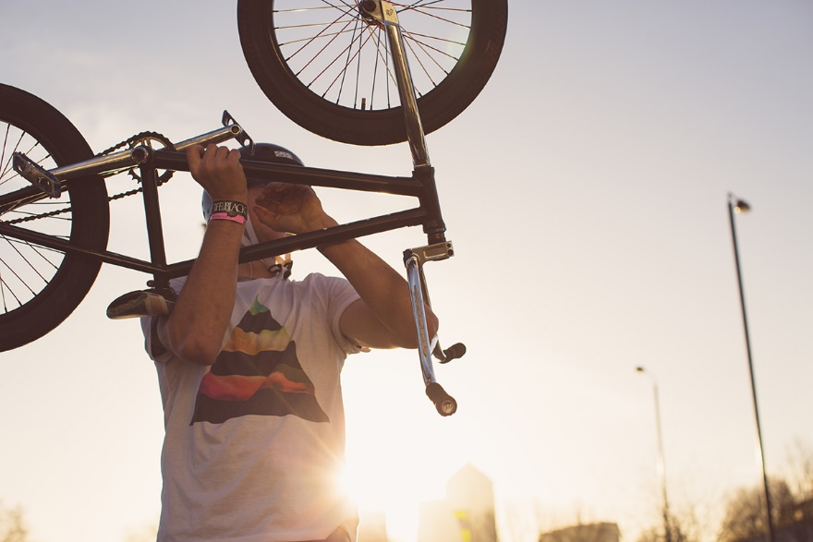
HOW MANY HOURS OF PHYSICAL ACTIVITY DO YOU COMPLETE IN A WEEK?
What is stopping you?
Regular Physical Activity impacts the brain, it…
boosts your memory
improves your concentration
helps reduce stress
lengthens attention span

Slide 3
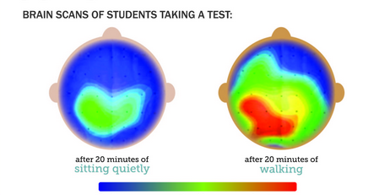
Physically active students have more active brains
Red areas are very active;
Blue areas are least active
https://lifehacker.com/20-minutes-of-exercise-before-an-exam-may-boost-your-pe-1541773646

Slide 4
Exercise can improve your exam performance
Exercise triggers the release of various hormones and chemical compounds in the body
Serotonin – involved in regulating your sleep cycles and boosting your mood.
Dopamine – positively influences learning and your attention span.
Norepinephrine –
affects motivation and mental stimulation

Slide 5
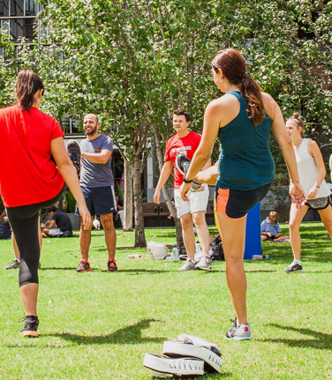
Exercise can improve your exam performance
Increased blood flow & the combination of hormones and neurotransmitters can improve:
Cognitive brain function
Your ability to focus for longer periods of time
Your stress levels
Memory retention

Slide 6
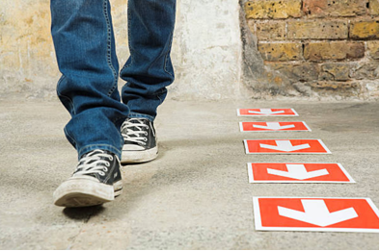
Why is it important to take breaks in your
revision?
You're less likely to get distracted while you are revising.
It's much better to spend 60 minutes revising well and 10 minutes on a break than to spend longer half revising and half playing with your phone.
Breaks actually make you work more effectively. After all that mental work, your brain needs a rest.

Slide 7
How to build exercise into your breaks…
Schedule regular breaks during your revision. This could be 60 minutes of revision, followed by a 10 minute break. Exactly what schedule is best varies from person to person.
Use your break for something relaxing and refreshing, but which won't distract you from getting back to work.
Do something that involves getting up from where you're revising and moving around.

Slide 8
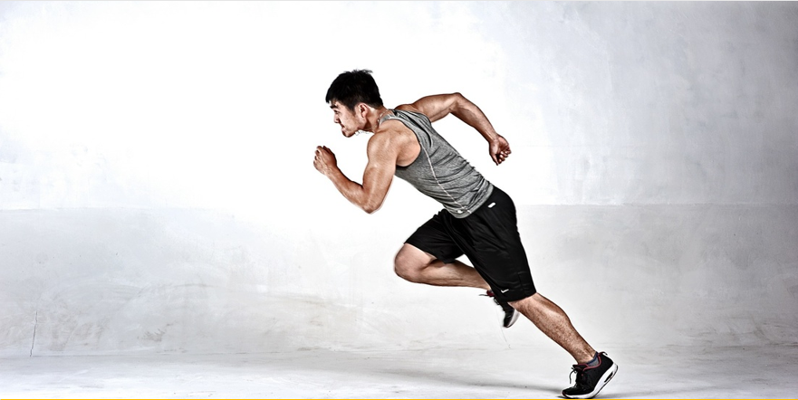
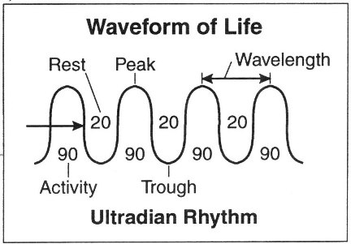
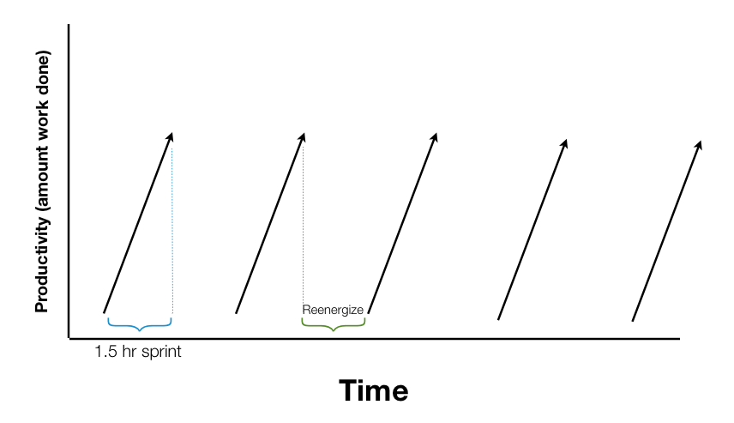
During revision - work in
60 to 90 minute intervals
Your brain uses up more glucose than any other bodily activity. Typically you will have spent most of it after 60-90 minutes.
So take a break, get up, go for a walk, have a snack, do something completely different to recharge.

Slide 10
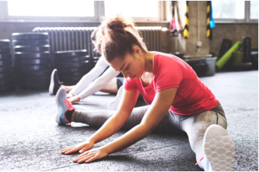
Fitting exercise into your schedule
Be flexible. Fit your exercise around your revision timetable, and find what works for you.
Shorter intense exercise is great during the exam period as it doesn’t take too long.
Take regular walks during the day to help you stay fresh and active.

Slide 11
Find a routine that works for you
6-7am
12-1pm
6-7pm
An early morning session could increase your focus for the rest of the day.
A lunchtime workout helps to break up the day.
Early evening exercise could help to de-stress & relax before bed.

Slide 12
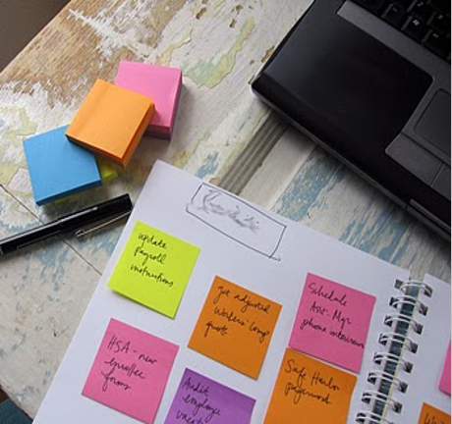
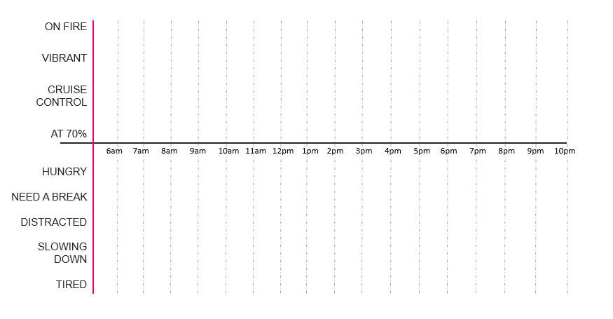
Your ideal work schedule
Plot your day from waking up to going to sleep in hourly blocks and identify when you are naturally:
Circadian rhythms
ON FIRE
VIBRANT
CRUISE CONTROL
AT 70%
HUNGRY
NEED A BREAK
DISTRACTED
SLOWING DOWN
TIRED
HUNGRY

Slide 13
Top tips to take care of yourself
Exercise regularly
Eat well
Sleep well
Relax often
Socialise & connect with others
Take time out for you

