Slide 1
Lambda
Kappa
Sigma
Gamma
Lambda
Kappa
Sigma
Gamma
Lambda
Kappa
Gamma
Nominees and shortlisting
Thank you to everyone that nominated a huge range of possible candidates to become House figureheads.
For obvious reasons we had to consider some criteria to ensure all the candidates were suitable.
Several men were nominated and also a couple of living women?!?
Lambda
Sigma
Kappa
In order to be transparent, the criteria we used is below:
Their body of work or influence led to changes in their field of expertise/changes in attitudes
They overcame adversity in order to help others/set examples
They are a role model to young people
They were not people who were famous simply because of who they married/inherited wealth and/or privilege
Kappa
Go to the next slides to see the nominated figureheads and the results for each house!
Sigma
Lambda
Gamma
Gamma
Gamma
Lambda
Lambda
Sigma
Gamma
Lambda
Kappa
Sigma
Gamma
Lambda
Kappa
Sigma
Gamma

Slide 2
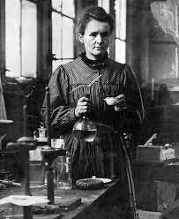
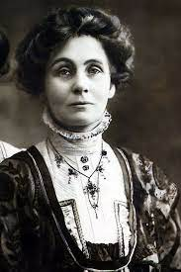
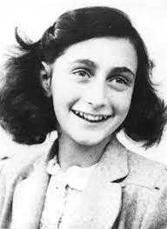
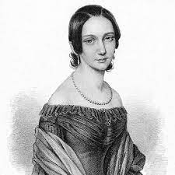
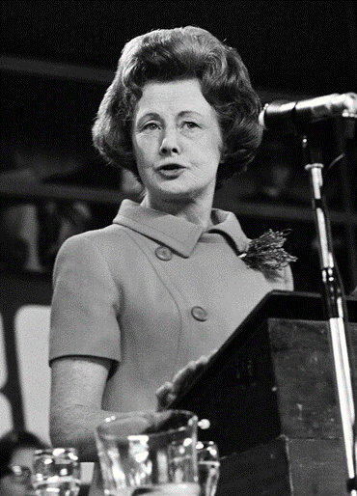
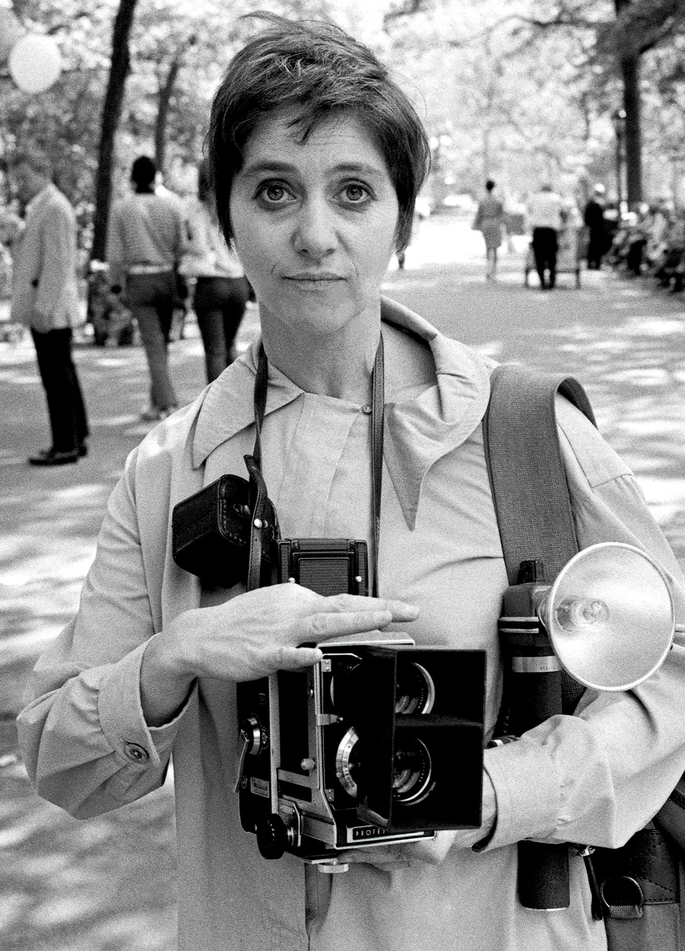
Lambda
Kappa
Sigma
Gamma
Lambda
Kappa
Sigma
Gamma
Lambda
Kappa
Gamma
Gamma’s Nominated Figureheads
Lambda
Sigma
Kappa
Kappa
Pankhurst
Frank
Curie
Sigma
Lambda
Gamma
Gamma
Gamma
Schumann
Arbus
Castle
Lambda
Lambda
Sigma
Gamma
Lambda
Kappa
Sigma
Gamma
Lambda
Kappa
Sigma
Gamma

Slide 3
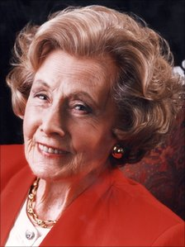
Lambda
Kappa
Sigma
Gamma
Lambda
Kappa
Sigma
Gamma
Lambda
Kappa
Gamma
Gamma Totals
Lambda
Students chose to keep the same names for all four houses: Gamma
Sigma
Sigma’s Chosen Figurehead
Barbara Castle
Kappa
Kappa
Sigma
Lambda
Gamma
Gamma
Gamma
Lambda
Lambda
Sigma
Gamma
Lambda
Kappa
Sigma
Gamma
Lambda
Kappa
Sigma
Gamma

Slide 4
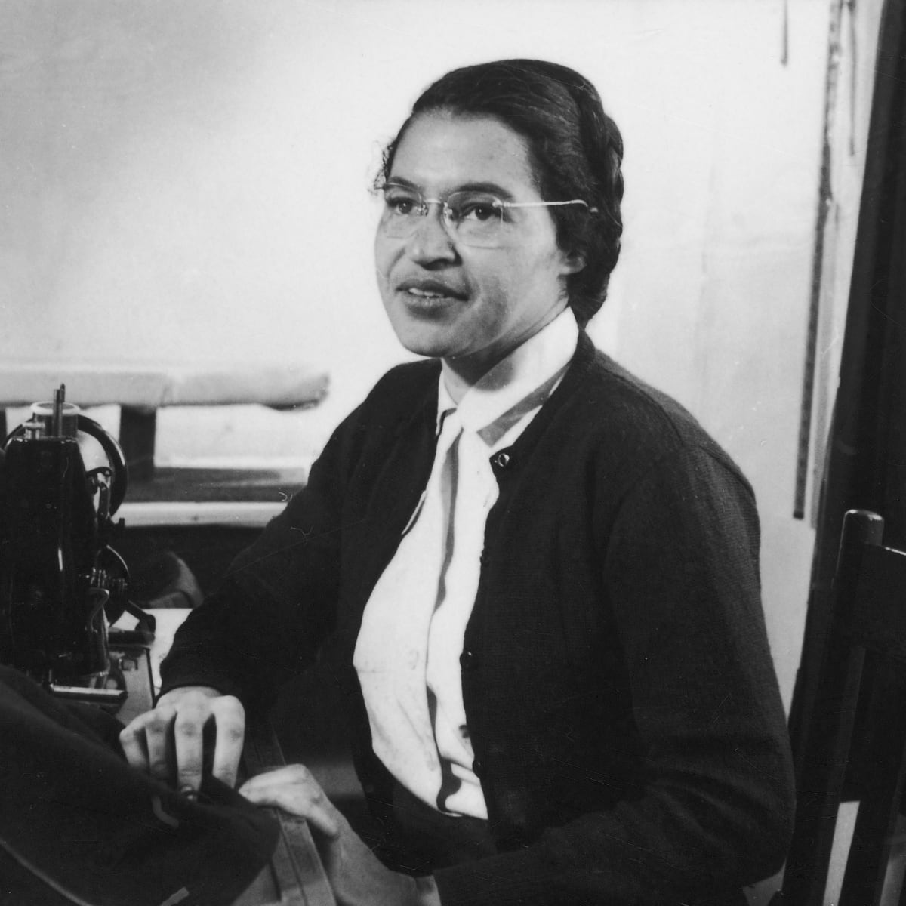
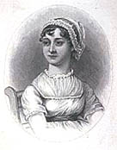
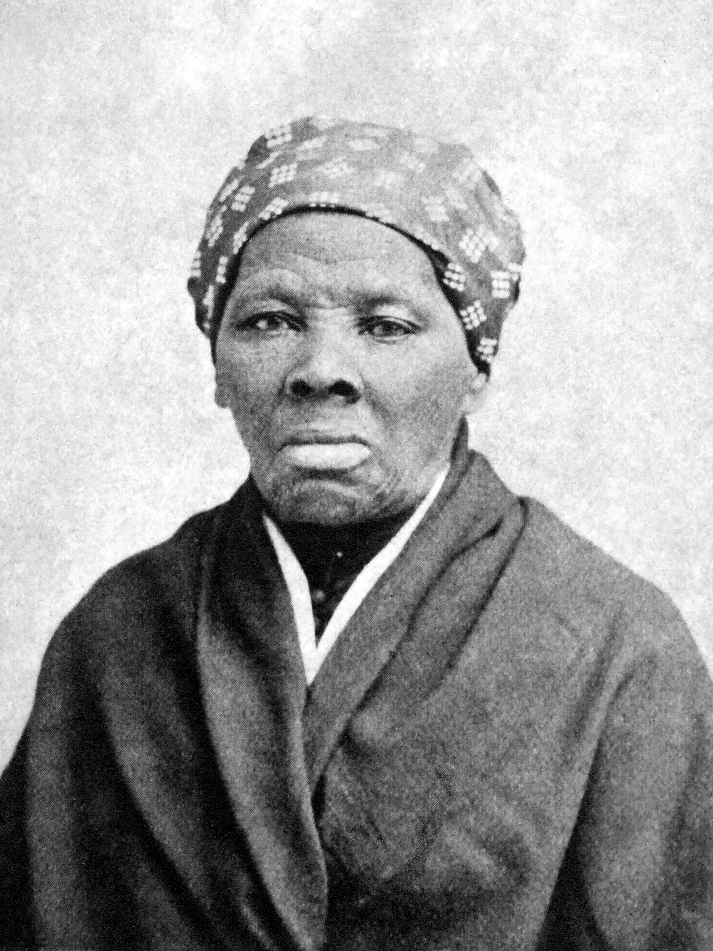
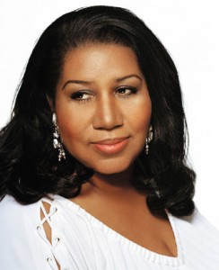
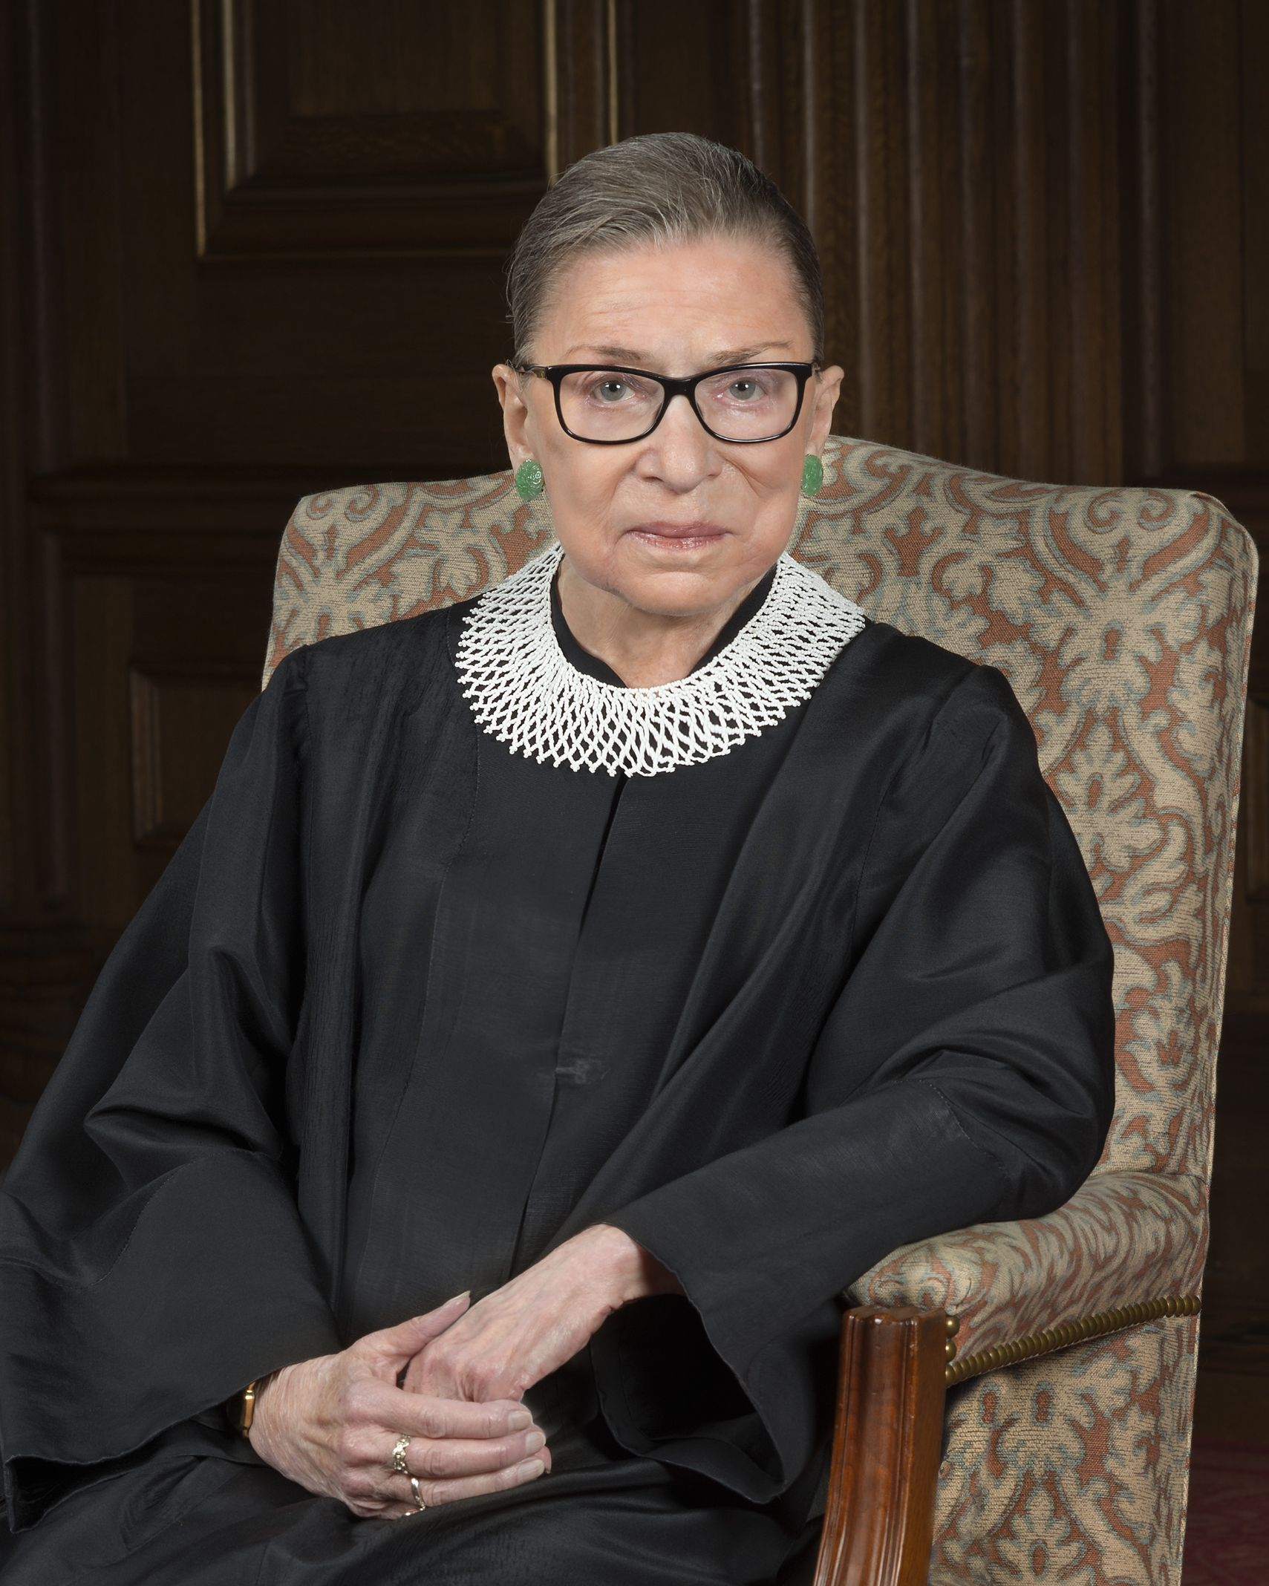
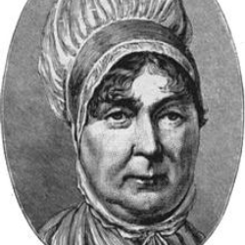
Lambda
Kappa
Sigma
Gamma
Lambda
Kappa
Sigma
Gamma
Lambda
Kappa
Gamma
Kappa’s Nominated Figureheads
Lambda
Sigma
Kappa
Kappa
Harriet Tubman
Rosa Parks
Jane Austen
Sigma
Lambda
Gamma
Gamma
Gamma
Aretha Franklin
Ruth Bader Ginsburg
Elizabeth Fry
Lambda
Lambda
Sigma
Gamma
Lambda
Kappa
Sigma
Gamma
Lambda
Kappa
Sigma
Gamma

Slide 5
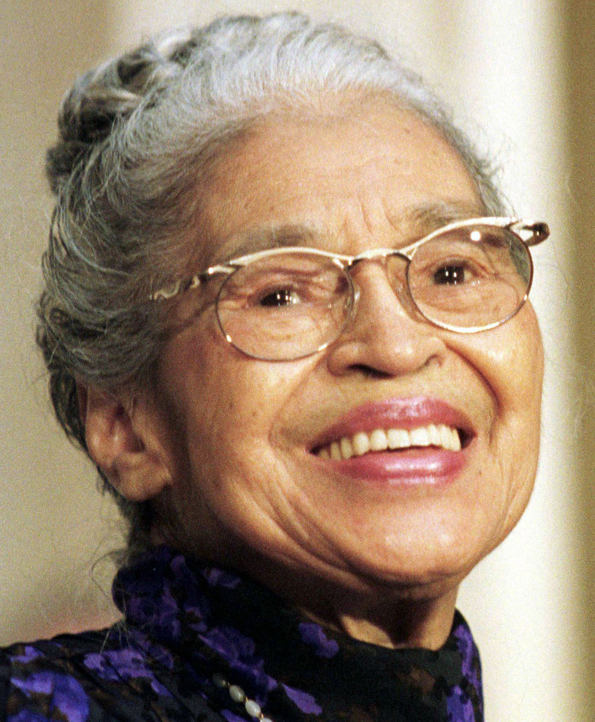
Lambda
Kappa
Sigma
Gamma
Lambda
Kappa
Sigma
Gamma
Lambda
Kappa
Gamma
Kappa Totals
Lambda
Students chose to keep the same names for all four houses: Kappa
Sigma
Kappa’s Chosen Figurehead
Rosa Parks
Kappa
Kappa
Sigma
Lambda
Gamma
Gamma
Gamma
Lambda
Lambda
Sigma
Gamma
Lambda
Kappa
Sigma
Gamma
Lambda
Kappa
Sigma
Gamma

Slide 6
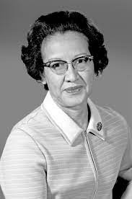
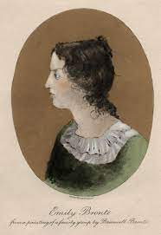
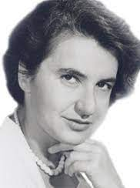
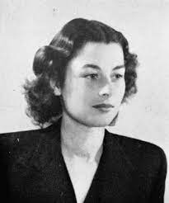
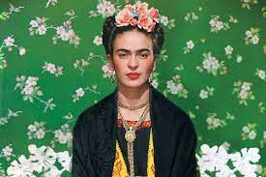
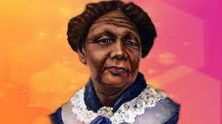
Lambda
Kappa
Sigma
Gamma
Lambda
Kappa
Sigma
Gamma
Lambda
Kappa
Gamma
Lambda’s Nominated Figureheads
Lambda
Sigma
Kappa
Kappa
Bronte
Franklin
Johnson
Sigma
Lambda
Gamma
Gamma
Gamma
Kahlo
Seacole
Szabo
Lambda
Lambda
Sigma
Gamma
Lambda
Kappa
Sigma
Gamma
Lambda
Kappa
Sigma
Gamma

Slide 7
Lambda
Kappa
Sigma
Gamma
Lambda
Kappa
Sigma
Gamma
Lambda
Kappa
Gamma
Lambda Totals
Lambda
Students chose to keep the same names for all four houses: Lambda
Sigma
Lambda’s Chosen Figurehead
Mary Seacole
Kappa
Kappa
Sigma
Lambda
Gamma
Gamma
Gamma
Lambda
Lambda
Sigma
Gamma
Lambda
Kappa
Sigma
Gamma
Lambda
Kappa
Sigma
Gamma

Slide 8
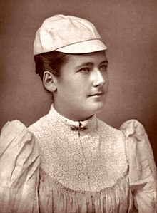
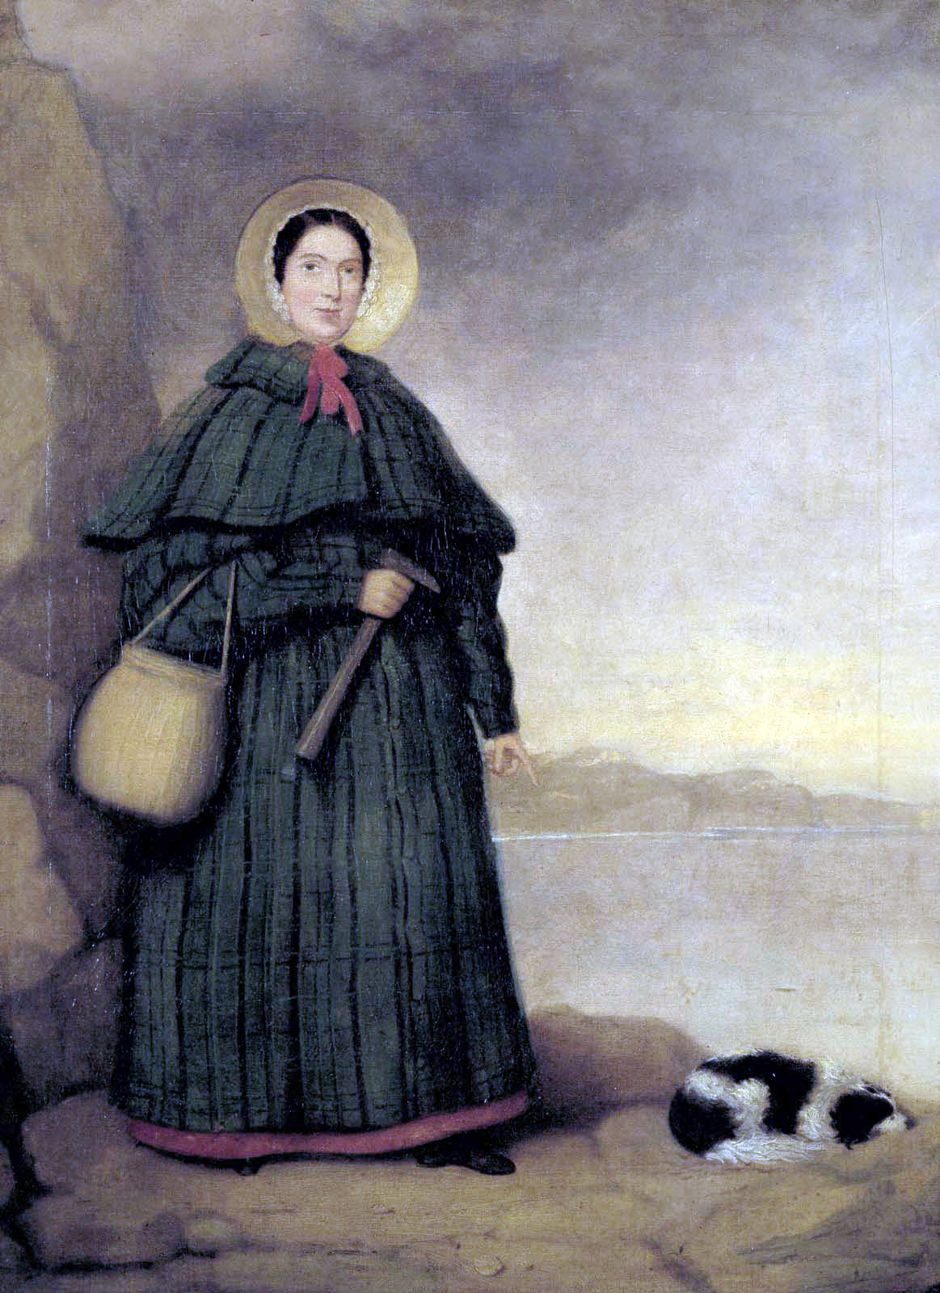
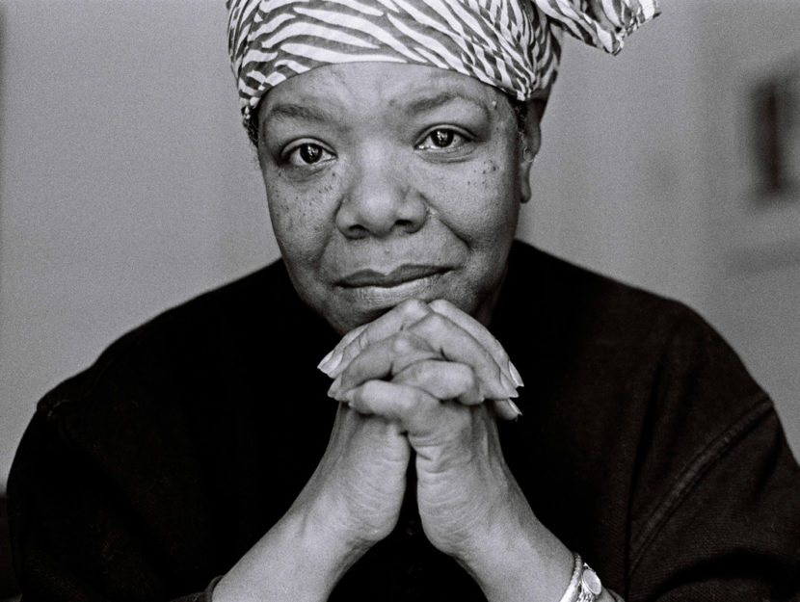
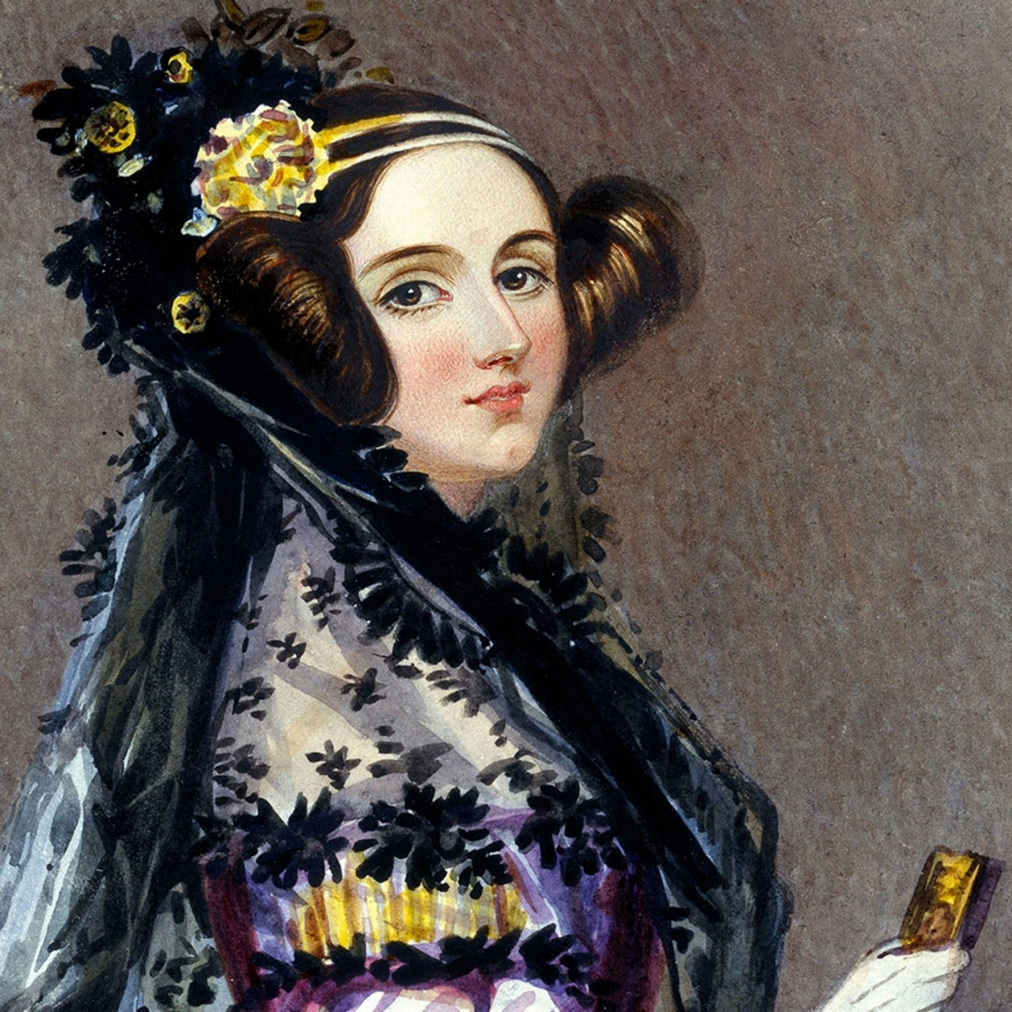
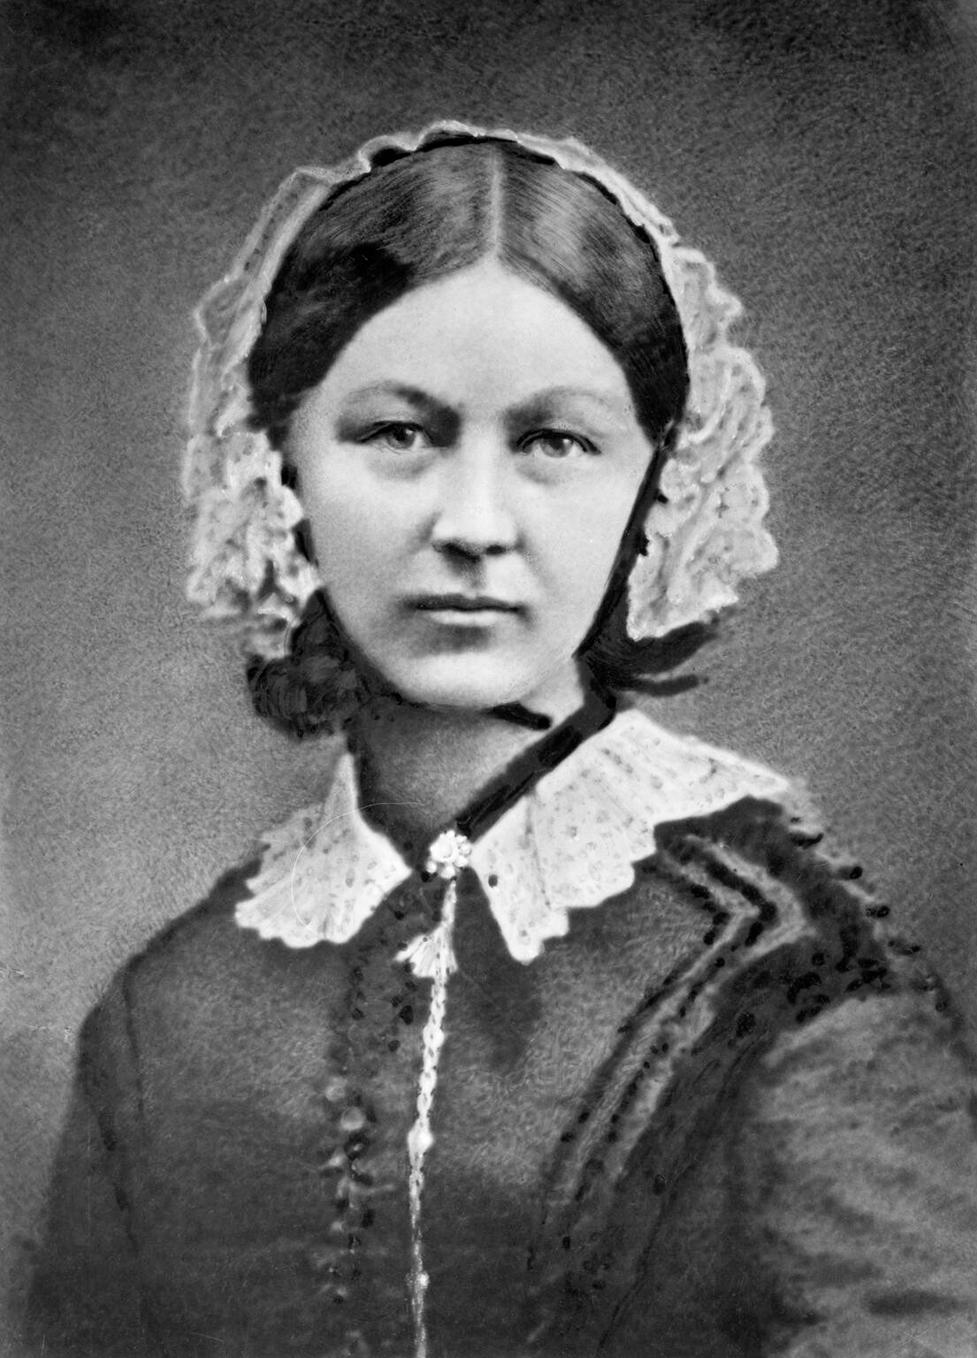
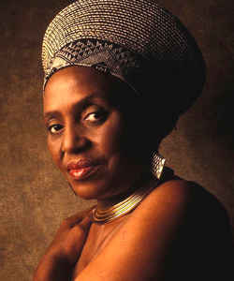
Lambda
Kappa
Sigma
Gamma
Lambda
Kappa
Sigma
Gamma
Lambda
Kappa
Gamma
Sigma’s Nominated Figureheads
Lambda
Sigma
Kappa
Kappa
Maya Angelou
Mary Anning
Charlotte Dod
Sigma
Lambda
Gamma
Gamma
Gamma
Ada Lovelace
Florence Nightingale
Miriam Makeba
Lambda
Lambda
Sigma
Gamma
Lambda
Kappa
Sigma
Gamma
Lambda
Kappa
Sigma
Gamma

Slide 9
Lambda
Kappa
Sigma
Gamma
Lambda
Kappa
Sigma
Gamma
Lambda
Kappa
Gamma
Sigma Results
Lambda
Students chose to keep the same names for all four houses: Sigma
Sigma
Sigma’s Chosen Figurehead
Ada Lovelace
Kappa
Kappa
Sigma
Lambda
Gamma
Gamma
Gamma
Lambda
Lambda
Sigma
Gamma
Lambda
Kappa
Sigma
Gamma
Lambda
Kappa
Sigma
Gamma

