Slide 1
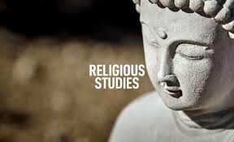
Welcome to
Head of Department: Miss L Bidwall
lbi@lpgs.bromley.sch.uk
Teacher of RS: Ms S Heaton
SH@lpgs.bromley.sch.uk

Slide 2
Why choose GCSE RS?
You will be challenged with questions about belief, values, meaning, purpose and truth, enabling them to develop your own attitudes towards religious issues.
You will also gain an appreciation of how religion, philosophy and ethics form the basis of our culture.

Slide 3
What skills will I develop through this course?
Understanding
Empathy
Reflection

Slide 4
Where could RS take me?
Doctors & Nurses need a firm understanding of medical ethics and many religious teachings have a direct influence on their job:
Abortion
Euthanasia
Organ Transplants
Blood Transfusions
Genetic
Lawyers & Judges must study Religion & Law as part of their training. Religion has influenced most of the laws in the UK, and also in other countries. They must have a good knowledge of religious beliefs & teachings as this may affect how a person lives and acts; they should also have a good knowledge of moral issues and ethics. It is vital that a lawyer is free from prejudice as they must treat everyone equally.
Social Workers must have a good understanding of religious and cultural issues in order to understand and empathise with the people they are entrusted to help. Religion and culture affect all aspects of life, from birth to death, in the home and at work. All social workers must be free from prejudice and must treat everyone with respect and equally!

Slide 5
What will I study at GCSE?

Slide 7
What if I have any further questions?
Please Contact
Head of Department: Miss L Bidwall
lbi@lpgs.bromley.sch.uk
Teacher of RS: Ms S Heaton
SH@lpgs.bromley.sch.uk

