Slide 1
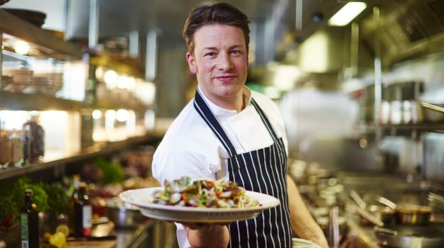
Making comparison, with Jamie Oliver
L/O:
To explore the idea of ‘idiolect’
analysis of the Jamie Oliver extract
Comparing the extract to a ‘foil’

Slide 2
Keywords for Spoken Language

Slide 3
a type of language consisting of words and phrases that are regarded as very informal and
are more common in speech than writing.
Slang
a particular form of a language
which is peculiar to a
specific region or social group
Dialect
Accent
The particular way of pronouncing a language, usually relating to region or social class.

Slide 4
the standard form of British English pronunciation, based on educated speech in southern England, widely accepted as a standard elsewhere.
Received Pronunciation
(RP)
the form of the English language widely
accepted as the usual correct form
Standard English

Slide 5
the dialect of a particular social class.
Sociolect
the speech habits peculiar to a particular person.
Idiolect

Slide 6
Idiolect
Everyone’s language is influenced by their accent, dialect and social group (sociolect). These build up a very individual pattern of language that is different for each person. This is called their idiolect.
A person’s idiolect is as unique as their fingerprint and can tell us a great deal about them.
Some people consciously choose words and phrases for their idiolect in order to try and make a certain impression on others.

Slide 7
What do you notice about Jamie Oliver’s idiolect?
You could consider:
What accent he has
What kind of words he says
How his personality comes through with the way that he talks.
https://www.youtube.com/watch?v=aQFA4nHwNyM

Slide 8
What do you notice about Nigella Lawson’s idiolect?
You could consider:
What accent she has
What kind of words she says
How her personality comes through with the way that she talks.
https://www.youtube.com/watch?v=5Ff0_Rwnev8
Notes:
https://www.youtube.com/watch?v=5Ff0_Rwnev8 - trifle
https://www.youtube.com/watch?v=_PF_mPwc-g8 – devils food cake
https://www.youtube.com/watch?v=X04FiZjr970 curry in a hurry

Slide 9
Keyword: idiosyncrasy
a mode of behaviour or way of thought peculiar to an individual.
Eg. "one of his little idiosyncrasies was always preferring to be in the car first”
Do you have any idiosyncrasies?
Are there any words that are idiosyncratic of your speech?
What idiosyncrasies do Jamie and Nigella have?

Slide 10
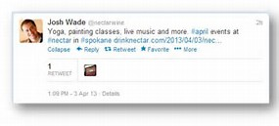
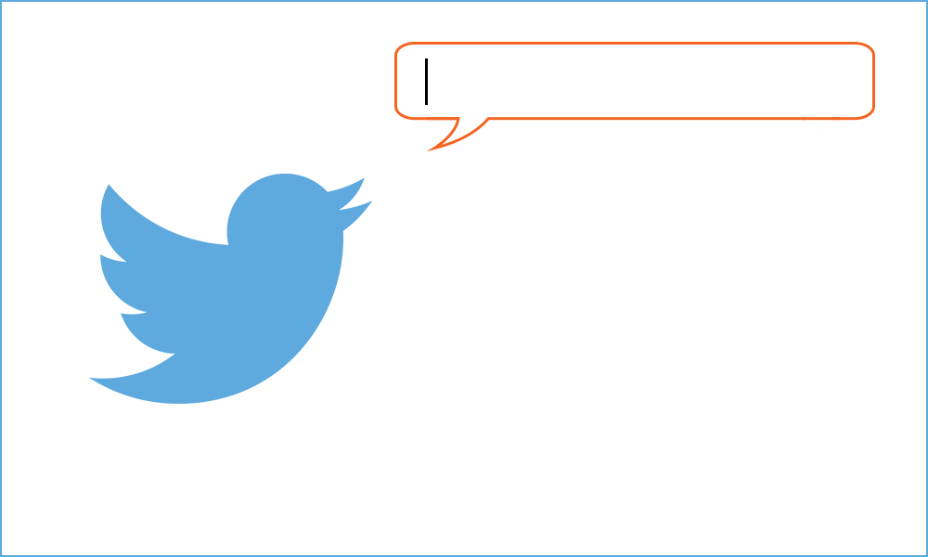
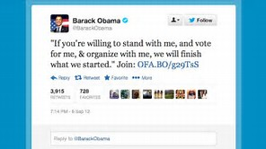
Mini task:
Write 2 tweets, using a maximum of 140 characters for each.
The first one should start ‘Jamie Oliver’s idiolect is unique because …’
The second should start ‘In contrast, Nigella….’

Slide 11
Have a read....
HAPPY DAYS TOUR LIVE!
The Happy Days Tour in 2001 was Jamie Oliver’s first live tour. This ‘behind the scenes’ interview was included as an ‘extra’ in the BBC DVD of the tour – Jamie Oliver: Happy Days Tour Live!
Jamie is filmed sitting in the outside broadcast truck surrounded by sound equipment and TV screens.

Slide 12
Annotate....
What linguistic features do you notice?

Slide 13
Can you find any examples of….
Backtracking
Interruption of the sequence of an utterance to include information that should have been included earlier. Indicates how speakers monitor what they say, and levels of correction and/or clarification.
Can you find any examples of….
Contraction
A shortened word.
Isn’t, don’t

Slide 14
Can you find any examples of….
Ellipsis
The omission of a part of a sentence, which can be understood from the context.
I’d like to go to the concert but I can’t (go to the concert).
Can you find any examples of….
False start
When a speaker begins an utterance, then either repeats or reformulates it. Indicate self-correction and monitoring.

Slide 15
Can you find any examples of….
Filler
Filler Used to gain thinking time (sometimes called ‘voiced pause’). Enable a speaker to pause and gain time to think.
Examples include: ‘er’, ‘um’, ‘well’.
Can you find any examples of….
Hedges
Vague words or phrases that are used to soften the force of how something is said.
Examples include: ‘perhaps’, ‘maybe’, ‘sort of’. Indicate politeness, uncertainty and cooperation.

Slide 16
Can you find any examples of….
Incomplete utterances
Speech that is not grammatically whole but which reflects the way people speak.
Going to the shop?
Can you find any examples of….
Paralinguistic features
The elements of non-verbal communication: a speaker’s gestures, posture and facial expressions.

Slide 17
A foil
(the term foil describes something that contrasts with something else, in a way that highlights its particular characteristics).

Slide 18
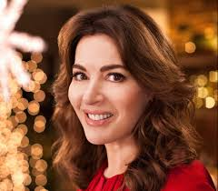
A foil for Jamie Oliver…
Read the transcript of Nigella Lawson, from an episode of Nigella Express, BBC.
You can also watch the episode here (from about 23 seconds in):
https://www.youtube.com/watch?v=POb8t2ucHds

Slide 19
Create a table
TEXT A: Jamie Oliver ‘Happy Days’ Tour Live | TEXT B: Nigella Express
Form
Purpose
Audience
Mode
Context
Register

Slide 20
Add to your table.....
What is the.....
Form
Purpose
Audience
Mode
Context
Register of the Nigella extract?
What linguistic features do you notice?

Slide 21
Making connections and comparisons (AO4)
What is similar and different about these two examples?
Do you see common aspects to their use of language?
Are there features of their idiolect or any idiosyncrasies that you can identify? How are they similar and different?

Slide 22
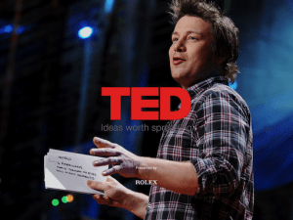
Another foil….
This time, we have another Jamie Oliver text to use as a foil.
This extract is from a TED Talk by Jamie Oliver.
TED describes itself as ‘a nonprofit organisation’ devoted to spreading ideas, usually in the form of short, powerful talks (18 mins or less). You can find many of its talks on YouTube or on the TED website.
https://www.ted.com/talks/jamie_oliver

Slide 23
Create a table
TEXT A: Jamie Oliver ‘Happy Days’ Tour Live | TEXT B: Jamie Oliver TED Talk
Form
Purpose
Audience
Mode
Context
Register

Slide 24
Add to your table.....
What is the.....
Form
Purpose
Audience
Mode
Context
Register?
What linguistic features do you notice?

Slide 25
Making connections and comparisons
What is similar and different about these two examples of Jamie Oliver speaking?
Do you see common aspects to his use of language?
Are there features of his idiolect or any idiosyncrasies that you can identify in both?
Are there significant differences and, if so, can you speculate about the reasons behind these?

Slide 26
Plan and write your answer to the following question:
Compare the ways in which the speakers of your texts use language to engage their audience across the two texts.
In your answer you should consider:
Context
Mode and genre
Purpose and audience
You should choose just TWO of the texts to compare. You could use Jamie compared with Jamie, or Jamie compared with Nigella.

Slide 27
Text A is a………………….. aimed at …………. It’s purpose is both to ………and ……………. Text B is a ……………… aimed at ……………………. Its purpose is ………………….. Despite these differences, the texts both share many characteristics such as…………………….
In Text A the register and conventions of… are used throughout, such as ………. (quote and technique)….
Both texts use …………………………. For example……….

