Slide 1
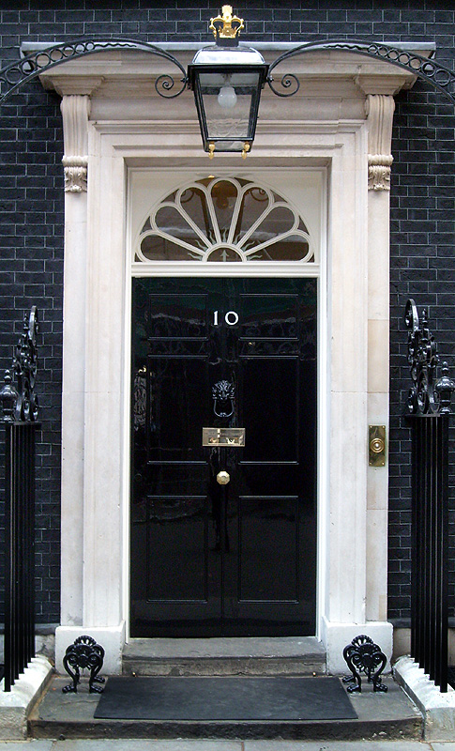
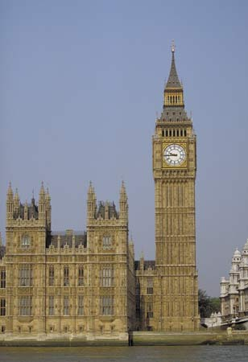
A Level Politics
Student Handbook
2021

Slide 2
A-Level Politics
WHAT DOES THE COURSE AIM TO DO?
It aims to:
Provide you with a ‘balanced education in politics’, and ‘understanding of the nature of politics, and an understanding in the context of the Untied Kingdom, including its local, national and European dimensions, and some aspects of comparative study of other political systems.’
You will be assessed on your ability to organise and present information, ideas and arguments clearly and logically in continuous prose using good quality English
THE SKILLS YOU WILL DEVELOP
· Knowledge and understanding of basic political ideas , concepts, structures and processes, the relationship between them and how they work at different levels.
· An ability to interpret and analyse political information in various forms and from various sources, and to apply a range of political ideas concepts and theories.
· An ability to evaluate arguments, theories, values and ideologies to explain political behaviour and suggest solutions to controversial issues.
· The skills to organise and present an argument with relevance, clarity and coherence using good English.

Slide 3
WHAT DOES THE COURSE INVOLVE?
What will you study?
Term | Topics Covered | Exam
Year 12:
Autumn Term | Component 1: UK Politics Democracy and participation Political parties Electoral system Voting behaviour and the media | A level: 2 hours - also include Core political ideas.
Spring Term | Component 2: UK Government The constitution Parliament Prime Minister and executive Relationships between the branches | A Level: 2 hours - also include Non-Core political ideas.
Summer Term | Core political ideas: Conservatism Liberalism Socialism Non-Core political ideas: Anarchism | A level: 2 exam papers 2 hours each to cover UK politics (including Core political ideas) and UK Government (including non-Core political ideas)
Year 13:
Autumn Term | Component 3: US Politics: US Constitution and federalism, US Congress, US presidency, US Supreme Court and civil rights, Democracy and participation, Comparative theories. | A Level: 1 exam paper on US Politics 2 hours
Spring Term
Summer Term | Structured revision based around content and skills. Multiple practice essay questions.

Slide 4
HOW WILL YOU BE SUCCESSFUL IN THIS COURSE?
YOU WILL NEED TO TAKE AN INTEREST IN CURRENT AFFAIRS AND POLITICAL ISSUES
This will involve:
Reading a QUALITY newspaper (such as The Times, Guardian, Telegraph, Independent or their Sunday equivalent;
magazines and specific politics journals such as Politics Review as well as the set textbooks.
Watching current affairs programmes such as Panorama, Despatches etc. and specific politics programmes such as ' A Week in Politics‘.
Watching the news or listening to 'Today' on Radio 4.
Discussing and debating political issues with both fellow politics students and others
Keeping a scrap book of press cuttings on politics and issues
Interest alone is not enough!
You will have to read widely and work hard to understand:
The institutions and main features of the British system of government and British politics.
How these work in theory and practice
The way they interact their strengths and weaknesses
The way they may change
Continuity is essential: Part-timers are of no use!
You will be given a variety of tasks:
Reading
Research
Short answers
Stimulus response questions
Essays.
To ensure quick feedback and a planned workload it is essential that all work is completed by set deadlines.

Slide 5
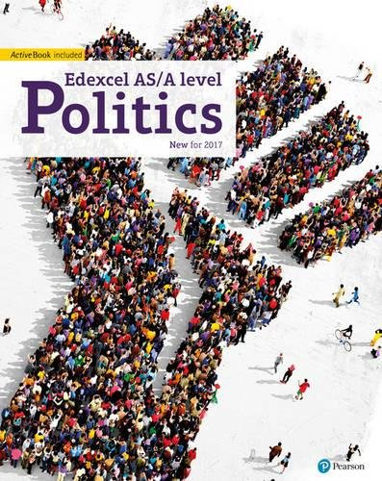
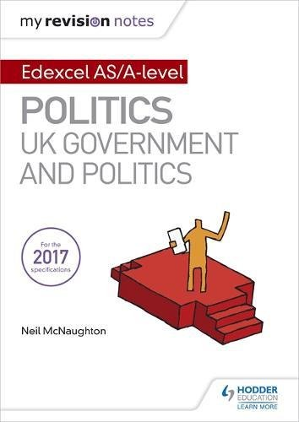
WHAT RESOURCES ARE AVAILABLE TO HELP WITH MY AS STUDIES?
You will need to purchase the following books before your return to school in September.
Set Texts:
Edexcel GCE Politics AS and A-Level Student Book (Edexcel GCE Politics 2017)
by Goodlad, Mitchell, Colclough, Levinson, Laycock, Schindler & Tomes
ISBN: 978-1292187020
This book is not published until 28th July 2017
My Revision Notes: Edexcel AS/A-level Politics: UK Government and Politics
By Neil McNaughton
ISBN: 978-1471889660
This book is not published until 26th January 2018
You will also need to purchase an annual subscription to the Politics Review.
https://www.hoddereducation.co.uk/Product/9781471890598.aspx

Slide 6
InductionTasks
TASK 1: complete the following activities. You will need to start with the booklet ‘Parliament Find Your Way’. Read the relevant pages in this booklet and then complete the following tasks.
You will need to ensure you have revised all of these topics, especially the key terms – you will be tested on this on your return to school in September.
1. The History of Parliament
Read page 4-5 in the booklet.
Visit www.parliament.uk/housesofhistory
Create a timeline to illustrate the ‘Journey to Democracy’.
2. Democracy
Read page 6-7 in the booklet.
Write a definition for the following words:
Democracy
Representative democracy
Direct Democracy
Politics
Dictatorship
Suffrage
Franchise
Watch ‘Democracy? You Decide’: http://www.parliament.uk/education/teaching-resources-lesson-plans/democracy-parliament-and-government-video/you-decide-video/
Answer the following question:
What would the UK be like if we didn’t live in a democracy?
What are the strengths and weaknesses of the UK system of democracy?
What other options are there and where are they in place right now?
3. The Constitution
Read page 8-9 in the booklet.
Write a definition of the following words:
Constitution
Uncodified constitution
Codified constitution
Parliamentary sovereignty
Devolution
The Human Rights Act
The European Union
The UK Supreme Court

Slide 7
4. The constitution: The EU
Read page 10-11 in the booklet.
Visit http://Europa.eu
Use your research to answer the following question:
In what areas can the EU make laws that the UK has to follow?
What happened if there is conflict between EU law and UK law?
Provide an example of where EU and UK law has conflicted – what was the outcome?
Make a list of the pros and cons of the UK being a member of the EU.
Study the results of the EU referendum on the 23rd June – what was the outcome? Why do you think this side won?
5. Parliament
Read page 12-17 in the booklet.
Write a definition of the following words:
Bicameral legislature
House of Commons
House of Lords
Monarch
Legislation
Scrutiny
Representation
Two-House system
Bills
The Queen’s Speech
Select Committees
General Committees
Public Bills Committee
Grand Committees
Liaison Committee
Prime Minister's Questions
Ministerial Questions
What role does the monarch have in our Parliament?
What is the benefit of a two-House system?
What is the key role of the committees?
What is the main different between the House of Commons and the House of Lords?
Who do MPs represent?
Constituents
MPs
Government Minister
Backbencher
The Executive
Government
Opposition
Cabinet
Speaker
The Legislature
Crossbenchers
Lord Speaker
House of Lords Act 1999
Hereditary Peers
Life Peers
Peers Spiritual

Slide 8
5. Parliament cont’d
What is the difference between the Executive and the Legislature?
How in the UK system of government do these over-lap? (Clue: this is called Fusion of Power)
What is the major problem with the House of Lords in terms of democracy?
What are the pros and cons of having an unelected second chamber?
Who would you nominate as a Life Peer and why?
High Court Judges also used to sit in the House of Lords: where do they now sit? Why do you think it was important to separate them from the work of the House of Lords?
6. Legislation: Making New Laws
Read page 12-17 in the booklet.
Write a definition of the following words:
Public Bills
Government Bills
Private Members Bills
Manifesto
Amendments
Division
Filibuster
Free Vote
Green Paper
Motion
Ping-Pong
Tellers
Wash-up
White Paper
Play the following game: www.parliament.uk/myuk
Answer the following questions:
What one law would you make and why?
How would you enforce the law?
What implications might it have for communities in the UK?

Slide 9
7. Elections and Voting
Read page 20-21 in the booklet.
Write a definition for the following words:
General election
Devolved Assembly/ Parliament elections
European elections
Local elections
By-elections
Referendums
Read through the different types of voting systems on page 21. Which do you think would be the best system for the UK to adopt for General Elections and why?
In 2011 there was a referendum on introducing AV. Research the outcome of this referendum. Why do you think this outcome occurred?
8. Elections and Voting: Trends and Types
Read page 22-23 in the booklet.
Write a definition for the following words:
Voter Turnout
Polling Day
Compulsory Voting
Separation of Powers
Proportional Representation
Why do you think voter turnout is low in Britain?
Should the UK make voting compulsory? What are the arguments for and against?
Should the voting age be lowered to 16? What are the arguments for and against?
You will soon be old enough to vote – how do you register to vote?
Go to www.parliament.uk/referendums and research another referendum that has happened in the UK. (Do not select the AV Vote or the EU referendum)
What was the topic of the referendum? What was the turnout? What was the
outcome?

Slide 10
9. Political Parties
Read page 24-25 in the booklet.
Write a definition for the following words/topics:
Political Party
Coalition government
Majority
Functions of political parties
Party Whips
Party Rebels
‘withdrawing the whip’
Which political party currently governs this country?
How many seats (or MPs) do the three main parties each have in the House of Commons?
Research the main political position of the three main political parties in the following areas:
Immigration
Taxes and the Economy
The NHS
Security, defence and foreign affairs
Jobs
Education
Law and Order
Benefits/ Poverty
Who would you vote for and why>
10. Pressure Groups
Read page 26-27 in the booklet.
Write a definition for the following words/topics:
Pressure Group
Lobbying
Petitions
Popular protest
Celebrity endorsement
Direct Action.
How is a pressure group different from a political party?
Research one pressure group – why is its aim? Who does it represent? What methods has it used to try to get its message across? How successful has it been?

Slide 11
Current Affairs Diary
TASK 2: in addition to these research projects you must also start your current affairs diary in the summer holidays. You will continue to keep this diary throughout your time studying politics in the sixth form.
How to keep a current affairs diary:
Each morning you must listen to, watch or read what is going on in the country and make a list of the top three news stories. You can do this whilst you are getting ready in the morning; whilst travelling into school on weekdays; by looking at one of the internet news sites and/or spending some time each day in the school library or at home looking at a newspaper.
In your diary make a list of the top three stories, including a brief outline of what has happened.
At the end of each week you must select one of these stories and write a short editorial on it. This should include:
An objective explanation of the issue. How it has progressed across the week.
Opinions from different viewpoints.
Your opinion – including where applicable alternative solutions to the problem or issue being criticised.
You will be provided with an exercise book to record your diary in. It is important that this is kept up to date and you bring it to all lessons. It will be collected in at random to check that you are up-to-date. The quality and quantity of work in this diary will form part of your termly skills check and effort scores will be awarded accordingly.
On your return to school in September:
Copies of the text books.
Your up-to-date current affairs diary
Your lever-arch folder set up with dividers to cover all the units you will be studying.
In the exercise book provided you must provide evidence that you have complete all the research tasks. Do not just copy and paste from the internet, particularly with word definitions – make sure that you really understand everything you write. This may mean that you need to do further research to develop your understanding.
There will be a knowledge and understanding test on your return. You will only be allowed to continue with the course if you pass this test.

