Slide 1
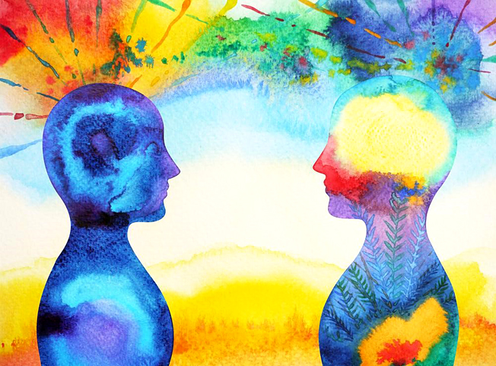
The Positive Power of Art
Do you recognise a feeling of joy that you can get when taking part in cultural activities such as music, museums, dance groups and theatre?
Getting involved with the Arts can have powerful and lasting effects on both physical and emotional health. Read the list to the right to find out, just how the Arts can benefit your well being.
Self-discovery: Creating art can help you acknowledge and recognize feelings that have been lurking in your subconscious.
Self-esteem: The process will give you a feeling of self-accomplishment which can be very valuable to improve your self-appreciation and confidence.
Emotional release: The greatest benefit of involving yourself in the Arts, is giving you a healthy outlet for expressing and letting go all your feelings and fears. Complex emotions such as sadness or anger sometimes cannot be expressed with words. When you are unable to express yourself, but you desire emotional release, making art may help you to do it.
Stress relief: Fighting anxiety, depression or emotional trauma can be very stressful for you both mentally and physically. Creating art can be used to relieve stress and relax your mind and body.

Slide 2
It is very important to know that you don’t have to be a talented artist in order to experience the all of the benefits that the Arts has to offer. Human beings are innately creative, and all you need to do to complete a creative activity successfully is, to be honest with yourself and your emotions. Once you unleash your creativity, your inner artist will quickly wake up.
Studies also show that creating art stimulates the release of dopamine. This chemical is released when we do something pleasurable, and it basically makes us feel happier. Increased levels of this feel-good neurotransmitter can be very helpful if you are battling anxiety or depression.
All you need for it is a willingness to experiment.
https://artfromthestreets.org/blogs/news/positive-benefits-of-creating-art
https://jamesclear.com/make-more-art
https://www.forbes.com/sites/ashleystahl/2018/07/25/heres-how-creativity-actually-improves-your-health/#759be8f213a6
Have a look at the fantastic Visual Art resources in the Visual Art, KS3 section on Firefly and experience the benefits for yourself.

