Slide 1
A Level Psychology Transition 2021 Task 5
Aims:
Recap some nervous system facts you may have learnt in GCSE science and maybe learn a few more
Reflect on how active learning can help you remember more!

Slide 2
Tasks
Read through the slides, completing the questions and checking your answers
Hopefully, most of the content will be revision from your GCSE science (but no worries if not! We will go through this together next year)
2. Take the Quiz
3. There are also two optional extension tasks and some further things to explore if you have the time and inclination to do so.

Slide 3
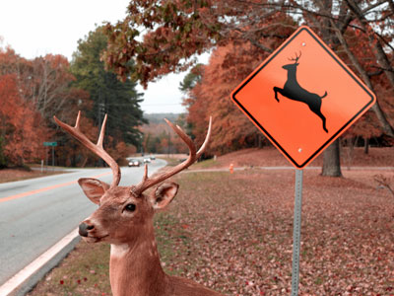
Responding to change – what does your nervous system do?
Lets you know what is going on around you and respond as needed
It carries electrical impulses (signals) – these travel very fast (1 to 120 metres per second)
Changes in the world around you are called stimuli
The changes in your environment (stimuli) are picked up by cells called receptors

Slide 4
Sense organs contain receptor cells....
Receptor cells (e.g. Light receptor cells in your eyes) are like most animal cells. They therefore have: a nucleus; cytoplasm; and a cell membrane.
Receptors are usually found clustered together in special sense organs, such as your eyes and your skin.
Your body has many different types of sensory receptors e.g. Pain receptors, light receptors etc.

Slide 5
Sense organs
Skin
Eyes
Receptors responsive to: touch, pressure, pain and temperature changes
Receptors sensitive to light
Ears
Nose and tongue
Receptors sensitive to sound
Receptors sensitive to changes in position for balance
Receptors sensitive to chemicals for taste and smell

Slide 6
Nervous system = Central nervous system + the Peripheral Nervous System
Brain + Spinal cord = central nervous system
(CNS)
Brain
Spinal cord
Peripheral Nervous system (PNS) consists of sensory and motor neurons.
Peripheral nerves carry sensory information to CNS and motor commands from CNS to muscles and glands.

Slide 7
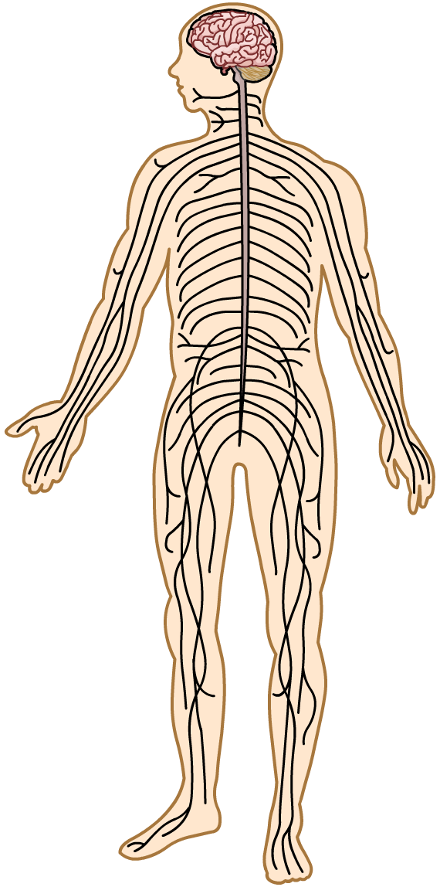
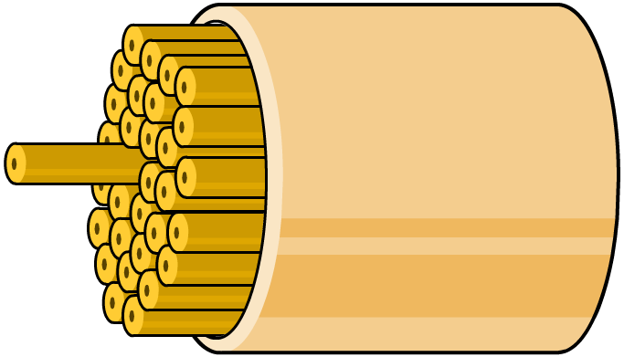
What are neurons?
Neurons cells that are specialised to conduct electrical impulses through the body.
A nerve is a bundle of many neurons
nerve
neuron

Slide 8
In GCSE Science you probably heard of these two types of neurons
Sensory neuron
Motor neuron
The next 2 slides will remind you of their structure

Slide 9
The term ‘Nerve fibre’ refers to the axon and the myelin sheath together
A sensory neuron
Nerve endings in central nervous system
dendrites
Sensory neuron cell body
axon
Direction of impulse
Myelin sheath
Sensory receptor

Slide 10
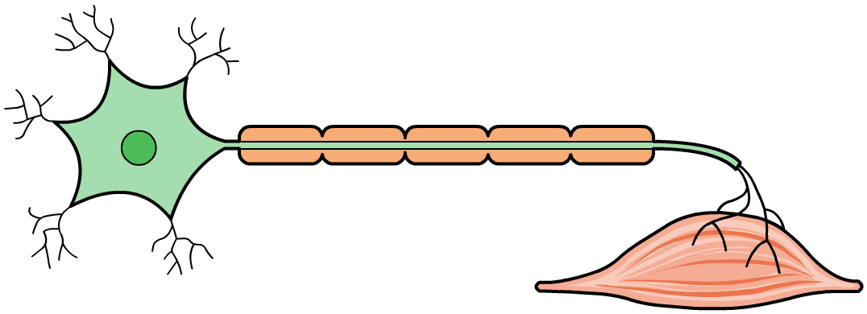
A motor neuron
Motor neuron cell body
Myelin sheath
Nerve endings in a muscle or gland
Axon
Direction of impulse
dendrites

Slide 11
In A level Psychology, you will learn about 3 types of neurons (can you spot similarities and differences?)
NB: The myelin sheath covers the axon of neurons and speeds up the transmission of nerve impulses. Gaps between the myelin sheath are called nodes of ranvier.
NB: A bundle of neurons is called a nerve.

Slide 12
Sensory Neurons
Carry nerve impulses from sensory receptors (e.g. receptor cells in the eyes, ears, skin etc.) to the spinal cord and the brain.
Sensory neurons convert information from these sensory receptors into neural impulses. When these impulses reach the brain, they are translated into sensations of, for example, visual input, heat, pain etc., so that the organism can respond appropriately.
Not all sensory information travels as far as the brain, with some neurons terminate in the spinal cord. This allows reflex actions to occur quickly without the delay of sending impulses to the brain. In reflex actions a relay neuron in the spinal cord coordinated the response to the stimulus (do you remember reflex arcs from GCSE science?).

Slide 13
Relay Neurons
Most neurons are neither sensory nor motor neurons
Most lie somewhere between the sensory input and the motor output.
Relay neurons allow sensory and motor neurons to communicate with each other.
These relay neurons (also known as interneurons) are found within the brain and spinal cord.

Slide 14
Motor Neurons
Carry messages from Central Nervous System to effectors (muscles or glands)
When stimulated, the motor neuron releases neurotransmitters that bind to receptors on the muscle and trigger a response which leads to muscle movement.
Glands release hormones

Slide 15
key words Recap. What is the key word?
1. A change in your environment e.g. light becoming dimmer
2. A cell specialised to detect changes in the environment (stimuli)
3. A cell specialised to carry electrical impulses (messages) around the body
4. An organ which contains lots of receptor cells e.g. your eyes

Slide 16
Answers
1 = stimulus
2 = receptor cell
3 = neuron
4 = sense organ

Slide 17
Reflex arc – do you remember these from GCSE Science?
Can you explain why we move our hand away first and then say “ouch”?

Slide 18
Answer
Because message about the heat travels from the receptor to sensory neuron to the relay neuron to the motor neuron to the muscle in the arming pulling your hand away travels faster than it travels from …
…The receptor, to the sensory neuron to the relay neuron to the brain maki

Slide 19
Do you remember..?
In GCSE science you probably learnt about how the electrical impulse which is conducted by a neuron passes to another a neuron
Can you remember this process? (answer on the next slide)

Slide 20
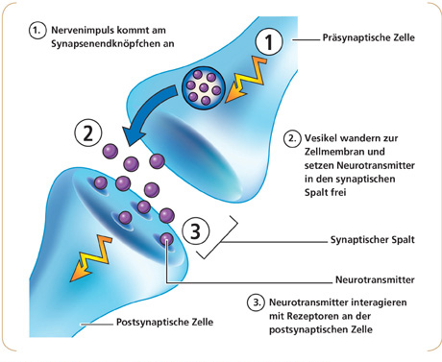
Answer: By the process of synaptic transmission
2. Neurotransmitters are released into the synapse
1. An electrical impulse reaches the end of the pre-synaptic neuron
3. Synaptic cleft
3. Neurotransmitters travels across the synapse to receptors on the post-synaptic neuron and bind to receptors they match.
4. An electrical impulse is initiated in the post-synaptic neuron

Slide 21
Extension: Active learning task
Create a model out of any resources you have at home. It can be of anything covered in these nervous system slides. One possibility could be to try to compare two different types of neurons. Add labels, take a picture and either email it to me (lg@lpgs.bromley.sch.uk) or add it to Instagram and tag @lpgs_psych instagram
OR
Create a video (click for an example!) of synaptic transmission or a reflect arc, you can create a simple stop motion video using your phones!
Try to show as much knowledge as you can. Email it to me (lg@lpgs.bromley.sch.uk) or add it to Instagram and tag @lpgs_psych Instagram

Slide 22
Challenge Extension
Do some research into the following contentious point online:
Now that we know that so much of our mental life and behaviour can be explained in by referring to the actions of our nervous system, we should get rid of psychological explanations. For example, if depression is caused by problems with serotonin activity in the brain, why bother with cognitive therapy?
Here is a link to get you started ☺
https://www.verywellmind.com/reductionism-definition-and-examples-4583891
Add your thoughts to the discussion forum!

Slide 23
If interested (spare time task)
Why not advance your knowledge
https://courses.lumenlearning.com/boundless-psychology/chapter/the-nervous-system/
Why not watch something interesting about the role biological factors play in our experience of the world
https://uk.rootsofempathy.org/susan-greenfield/ and share what you’ve learnt in the forum

