Slide 1
Sixth Form Taster Lesson
English Literature

Slide 2
English Literature:
Learning Outcomes
1 To analyse the most famous line in English Literature
2 To consider how Literature study encourages you to explore the meaning of your existence.
Do It Now:
This is arguably the most famous line in the whole of English Literature: ‘To be or not to be, that is the question:’ Do you know: who wrote it / which text it comes from / who says it? What ideas could the character who says this be trying to express?

Slide 3
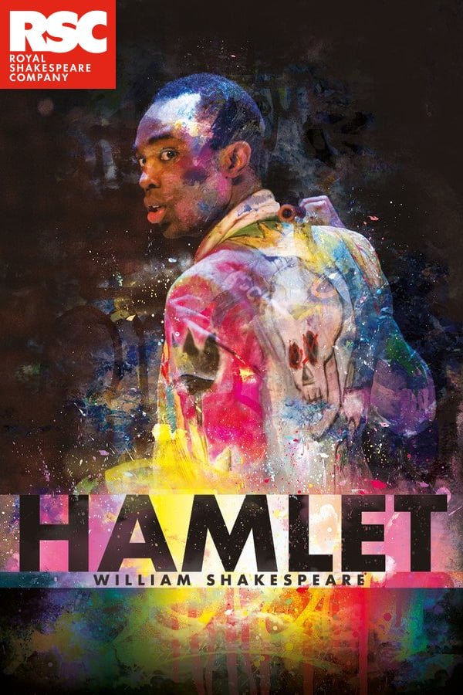
‘To be or not to be, that is the question:’
Who wrote it: William Shakespeare
Which text does it comes from: Hamlet, Prince of Denmark
Who says it: Hamlet himself
What ideas could the character who says this be trying to express? How do they feel?
Does Papa Essiedu’s acclaimed performance of the line for the RSC provide you with additional ideas?

Slide 4
‘To be or not to be, that is the question:’
Who wrote it: William Shakespeare
Which text does it comes from: Hamlet, Prince of Denmark
Who says it: Hamlet himself
What ideas could the character who says this be trying to express? How do they feel?
Is asking himself whether he should live or die
Suffering from mental health problems, depressed
Desperate and despairing

Slide 5
‘To be or not to be, that is the question:’
Could analysing the poetic rhythm help us understand this line further?
- It is written, like most of Shakespeare’s drama, in ‘iambic pentameter’.
- This involves a ten-beat line with an ‘off-on’ stress pattern.
Here’s the line again with its stress pattern:
‘To be or not to be that is the question’
Can we interpret the line in a more specific way if we consider the particular words Shakespeare chooses to emphasise through the poetic structure?
Do you notice anything else a little unusual about this line as an example of iambic pentameter?

Slide 6
‘To be or not to be, that is the question:’
Could analysing the poetic rhythm help us understand this line further?
Stress on ‘is’ is defiant in tone:
people ignore the importance of this question
‘To be or not to be that is the question’
Emphasising & juxtaposing ‘be’ and ‘not’ strengthens this
sense of a dichotomy between two options:
‘living’ and simply ‘not living’ The emphasis on question is strong
because it is the final word/idea of the line – also, S. adds an extra beat to the usually ten- syllable line. Reveals Hamlet’s obsession with the great ‘questions’ of existence.
Task: Quick paragraph (type into the chat)
In one brief paragraph, explain why you think Hamlet says this. Try to include direct reference to the line, and some language analysis, to help strengthen your explanation.

