Slide 1
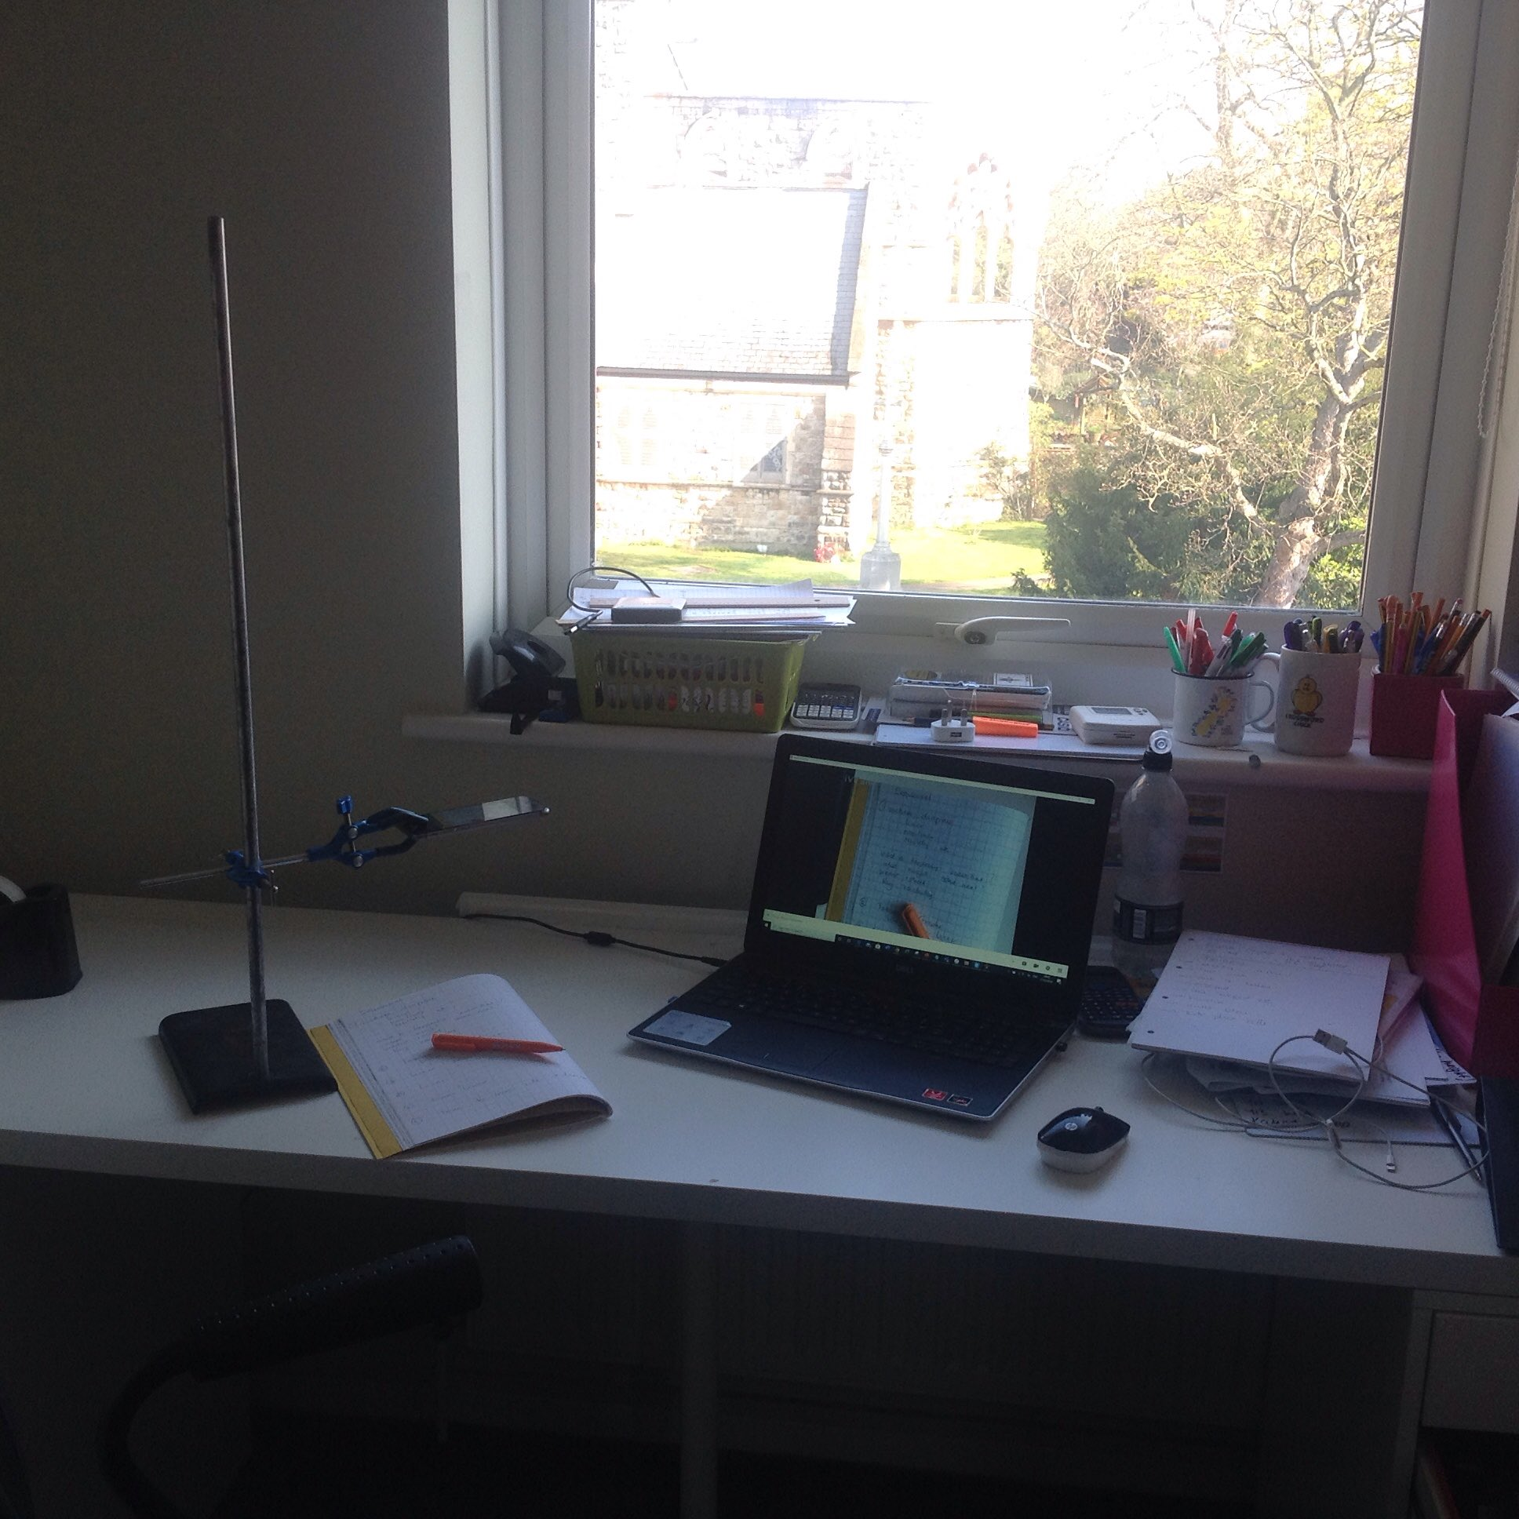
Anne’s home made visualiser

Slide 2
I have found two ways to use my phone as a visualizer:
Via webcam app
Within MS Teams

Slide 3
Method 1
You will need:
Phone/tablet
Clamp stand
Web cam app

Slide 4
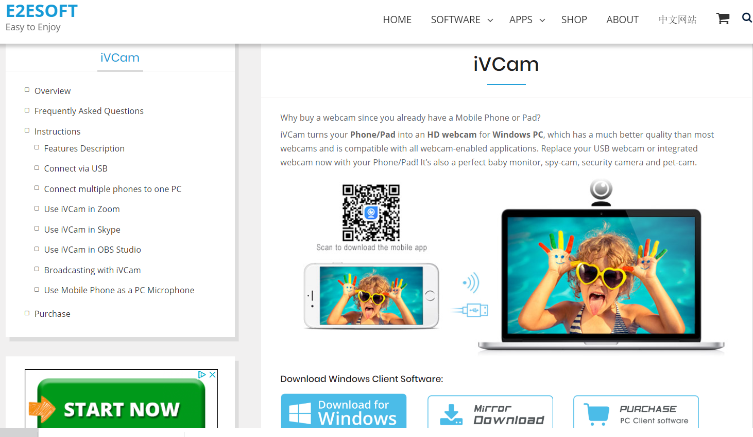
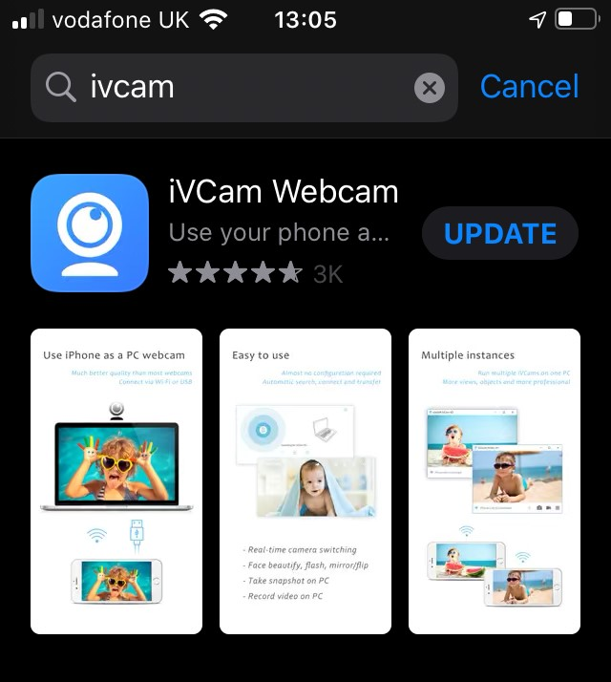
Web cam app
Install on your phone and computer
https://www.e2esoft.com/ivcam/

Slide 5
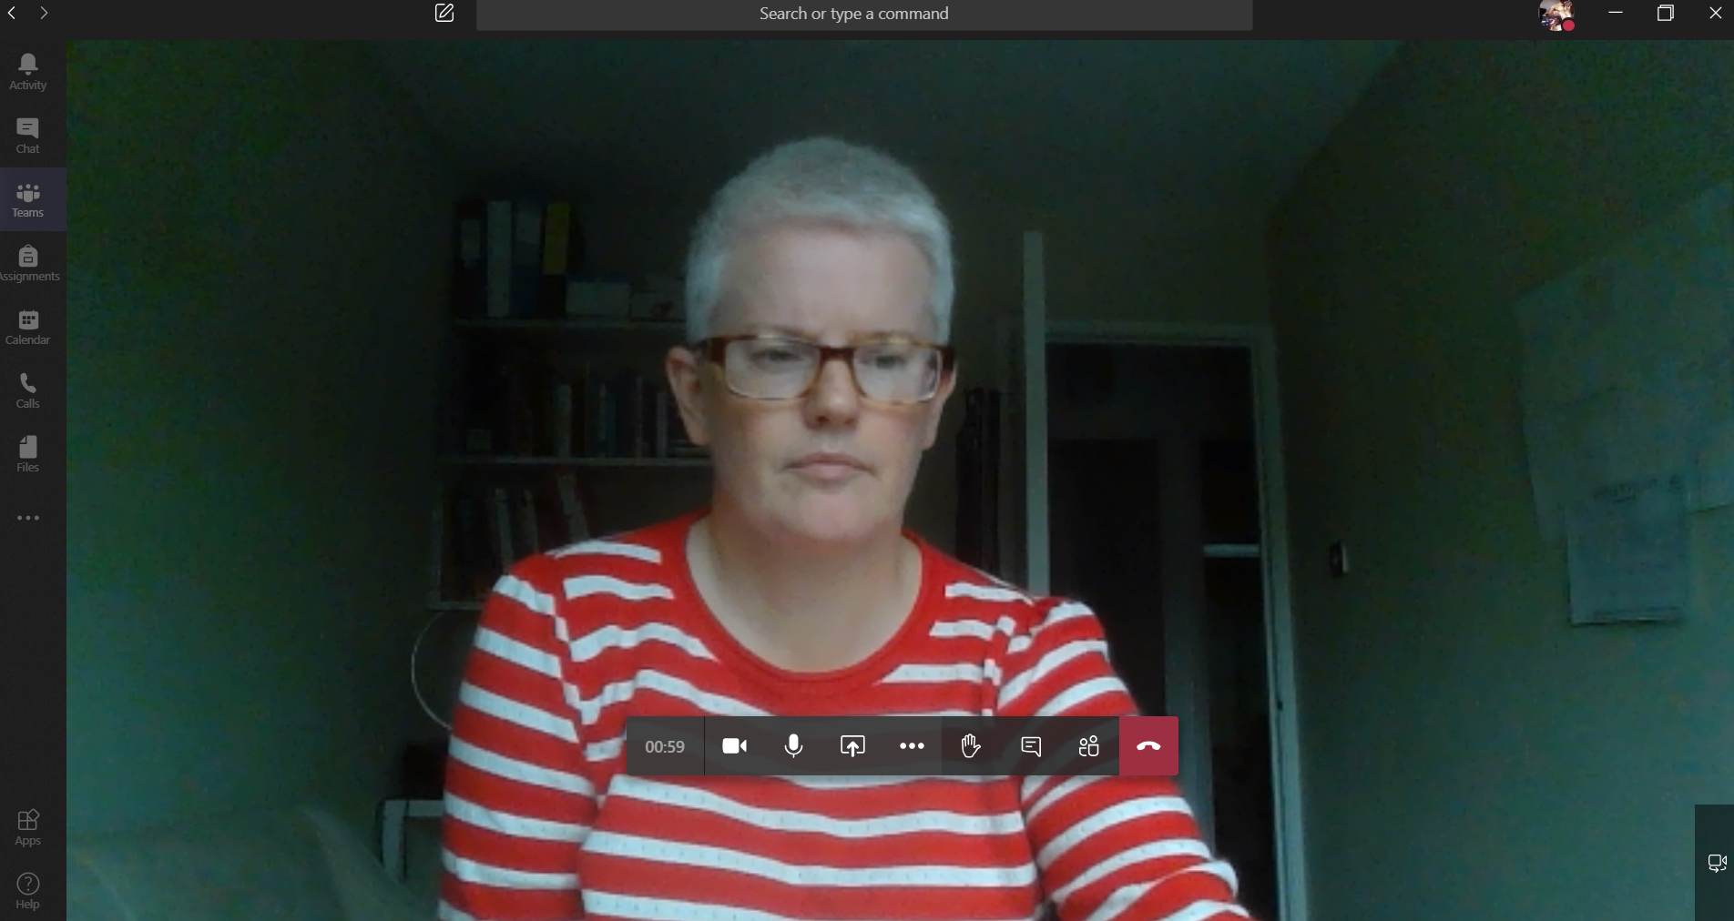
1) Launch Teams meeting as normal
2) Select the webcam

Slide 6
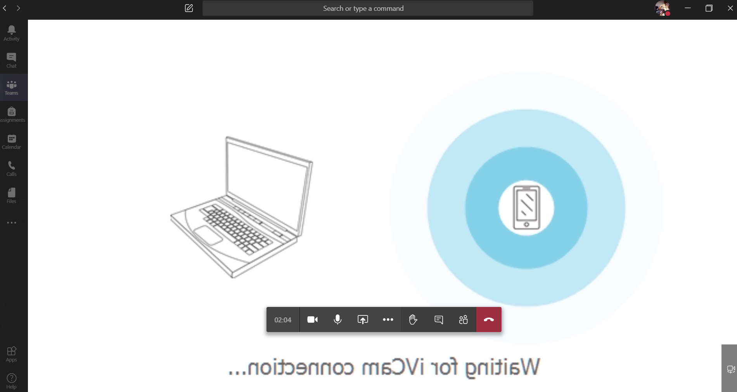
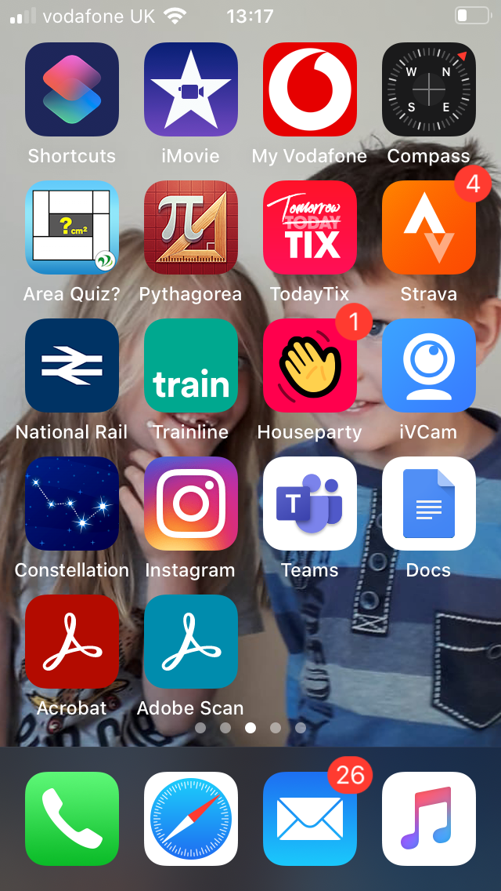
3) Launch webcam on your phone

Slide 7
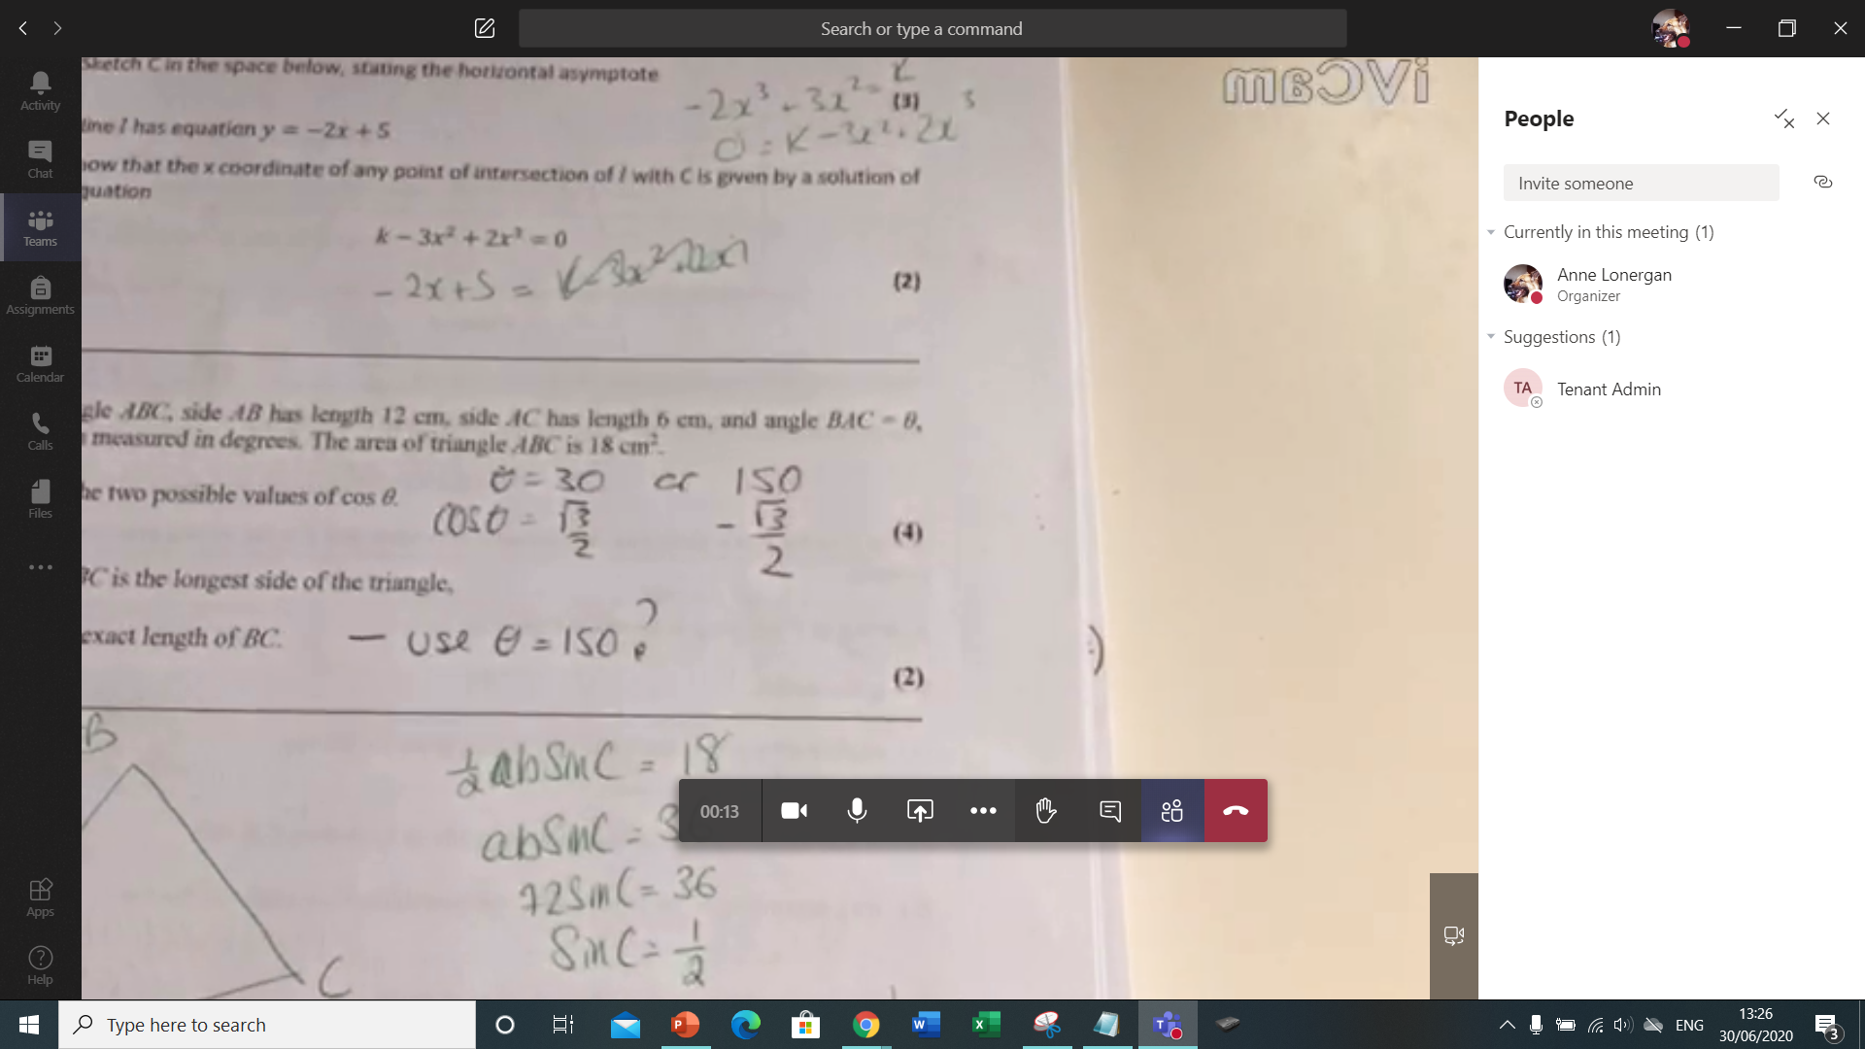
4) The computer will now show whatever your phone is pointed at
5) You can toggle between the phone camera and your PC camera

Slide 8
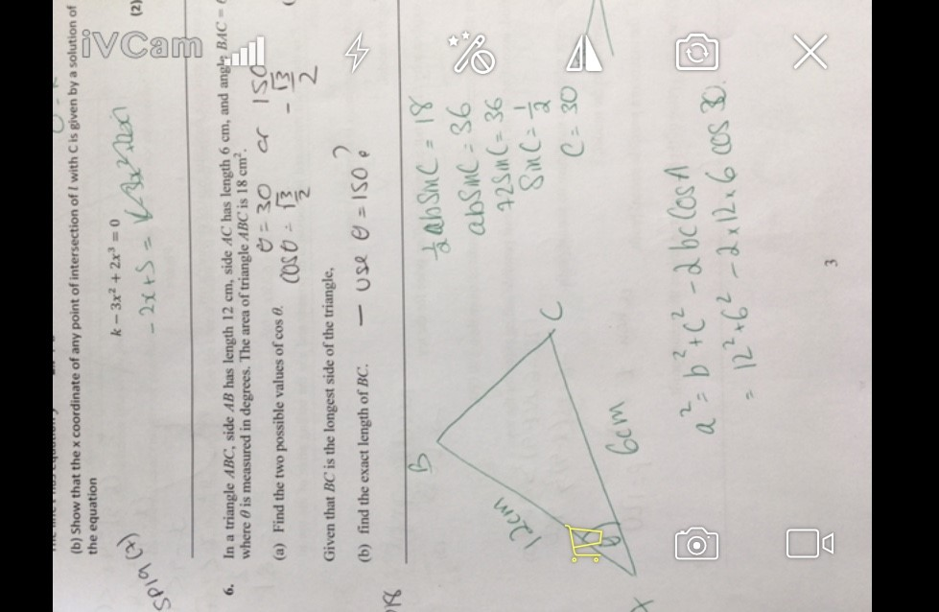
6) Use this button on the App to make sure work is the right way round for students to read.

Slide 9
Clamp stand
Ask a friendly science teacher or …..

Slide 10
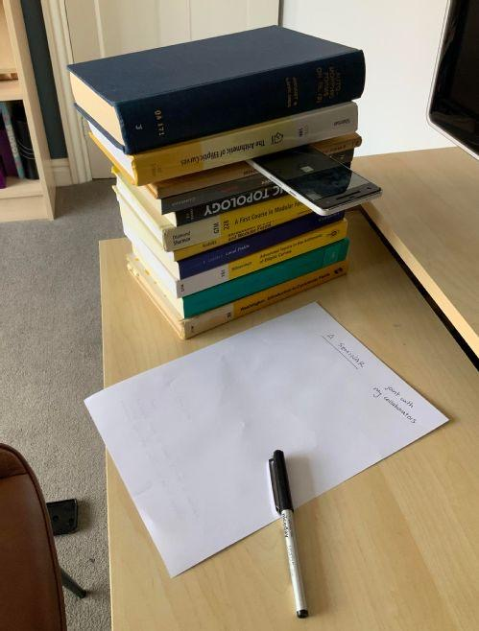
Improvise

Slide 11
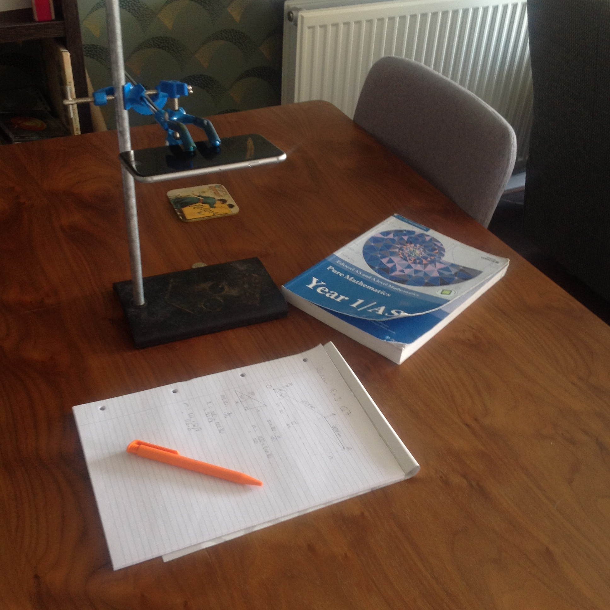
The clamp stand also helped when making short videos of worked solutions to individual questions share with my students

Slide 12
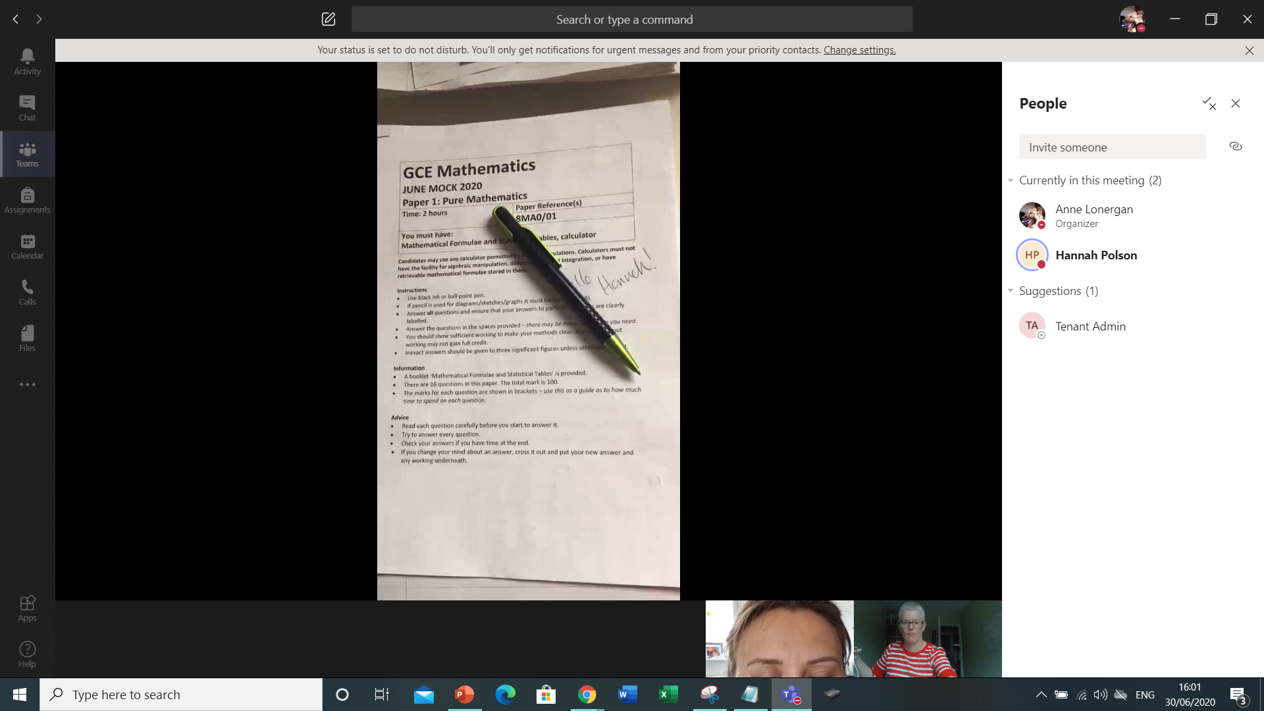
Method 2: Alternatively join Teams call on two devices…..

Slide 13
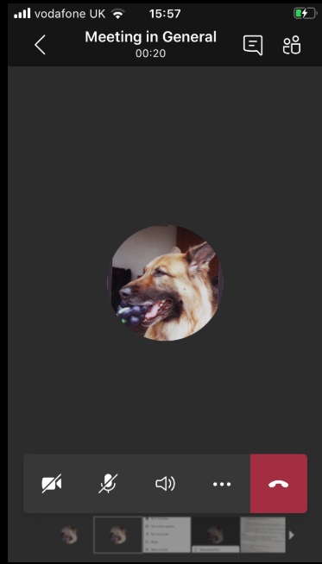
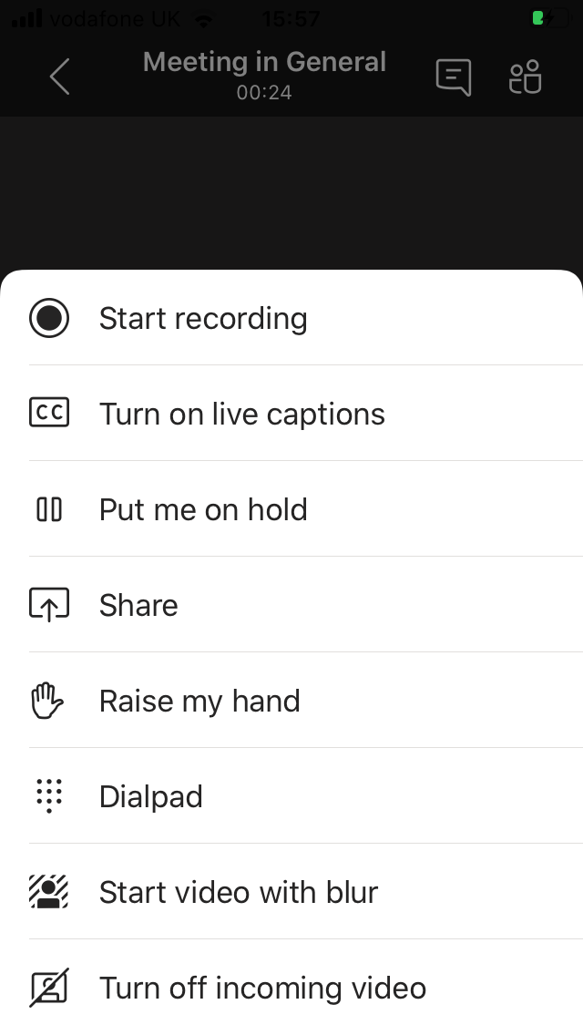
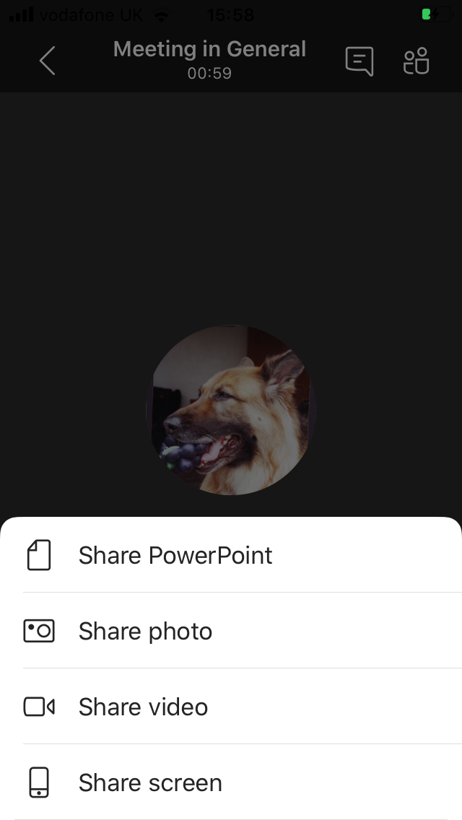
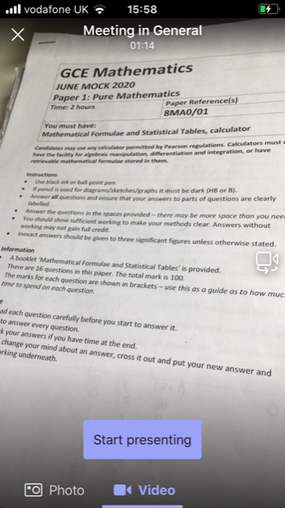

Slide 14
Set up your phone in the clampstand as before
Mute one of the devices

