Slide 1
How the Adobe Scan App has helped me during lockdown

Slide 2
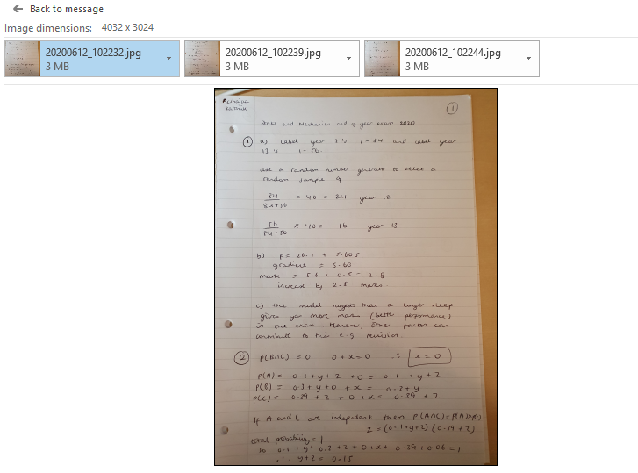
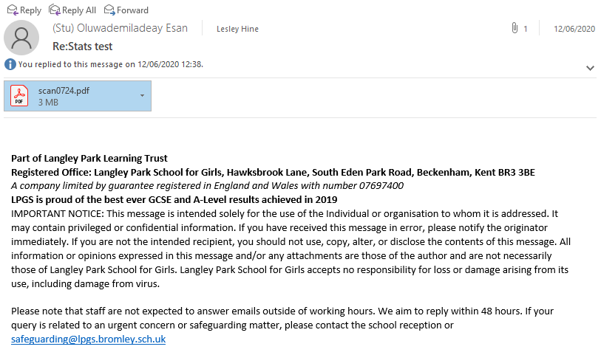
Students submitting work
Photo on phone emailed Photo on phone converted to PDF and emailed

Slide 3
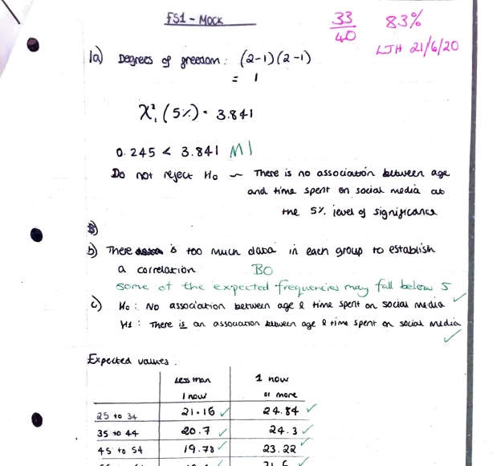
Print mark, scan and return

Slide 4
Sharing my worked solutions

Slide 5
Sharing Worked Solutions in Power Point lessons (with or without audio)

Slide 6
Vectors and Geometric Proof
O
a
A
.
OABC is a trapezium.
$\vec{\text{OA}}$ = a and $\vec{\text{O}\text{C}}$ = c.
CB is parallel to OA and CB = 2OA
c
.
M
C
B
X
M is the midpoint of AB and X divides CB in the ratio 2 : 3.
Write in terms of a and c
(a) $\vec{\text{CB}}$ (b) $\vec{\text{AB}}$ (c) $\vec{\text{OM}}$ (d) $\vec{\text{OX}}$

Slide 7
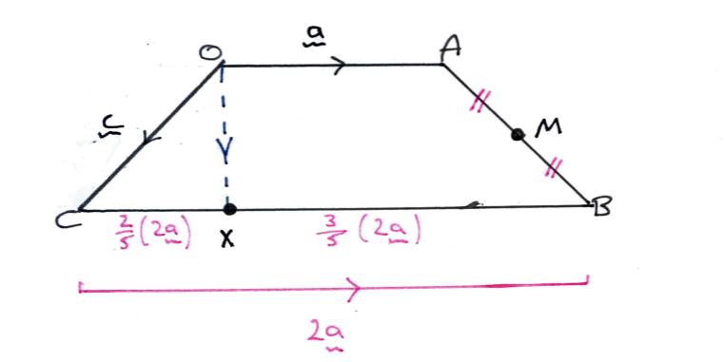
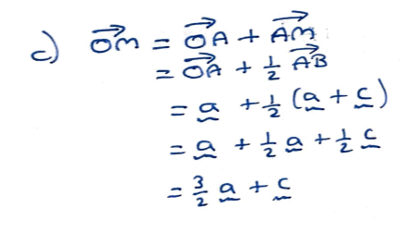
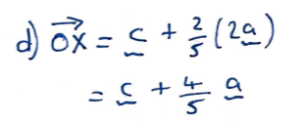

Slide 8
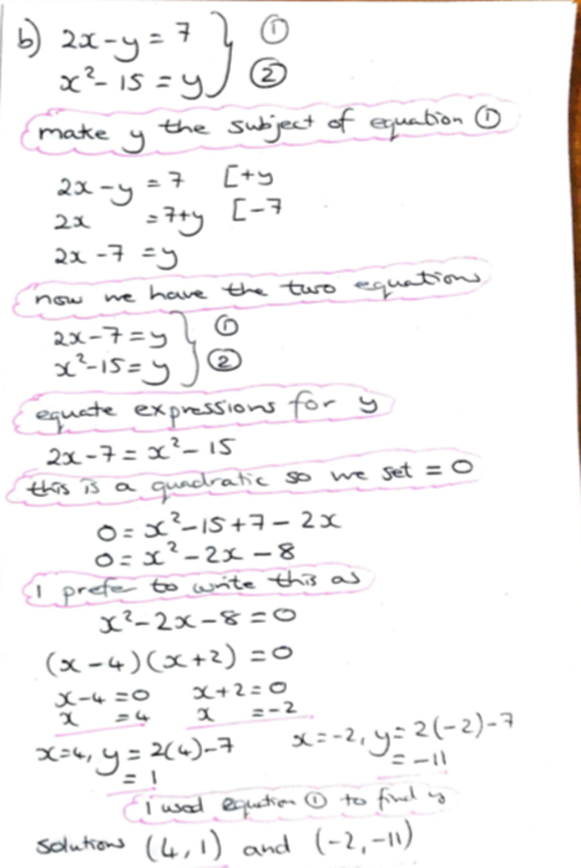

Slide 9
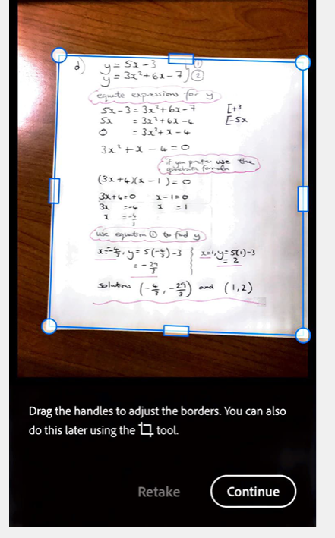
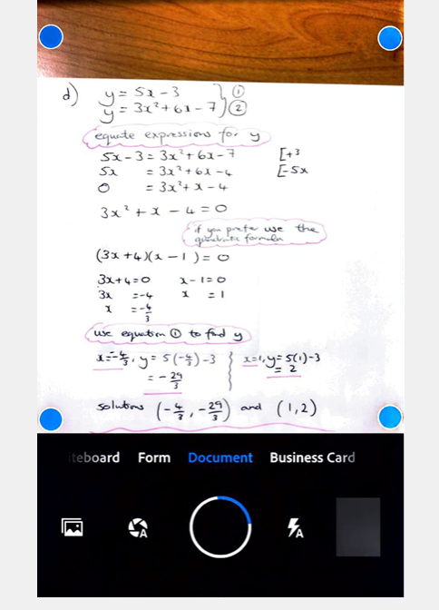
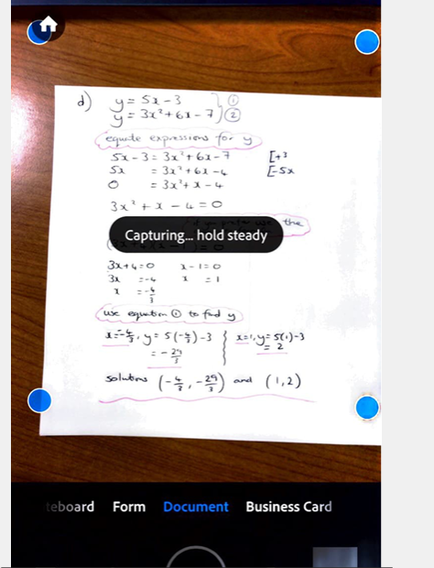
Take photo to scan
Choose existing photo from your phone

Slide 10
